Slide 1

Machine Learning and AI
DSBA 6190-U90 | Colby T. Ford, Ph.D.

Slide 2
Overview
Machine Learning Options in the Cloud
Azure Machine Learning Studio
AutoML
Azure AI Studio
Open-Source Models vs. OpenAI
Cognitive Services

Slide 3
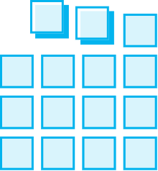
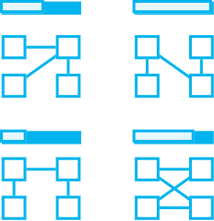
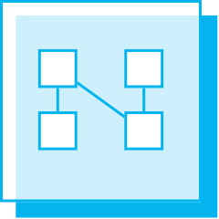

Intro to Machine Learning
Prepare Data
Build & Train
Deploy
Connect to various sources to ingest data
Train with the data to establish a model
Deploy the model and track performance

Slide 4





Machine Learning and AI Options in the Azure Cloud
DSVM
Azure AI Services
Databricks
Machine Learning
Studio
AI Foundry

Slide 5
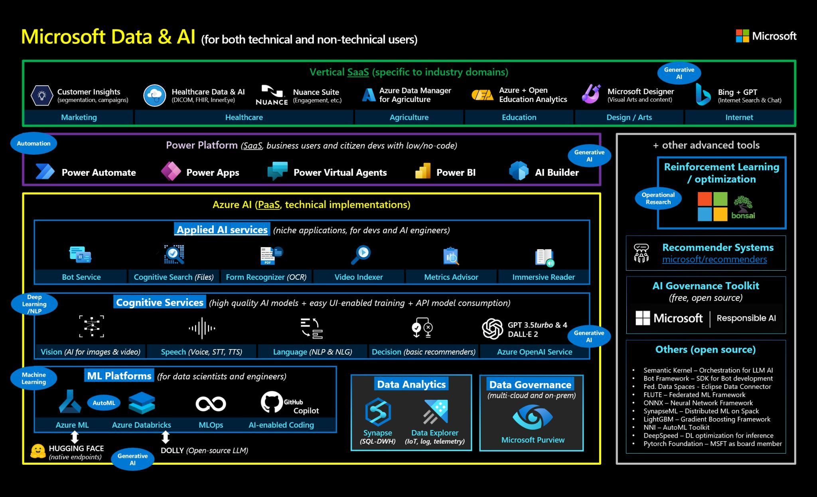

Slide 6
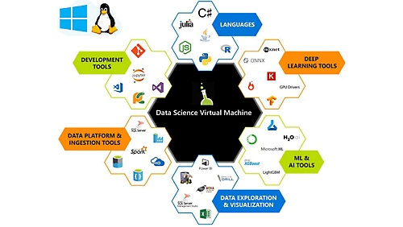
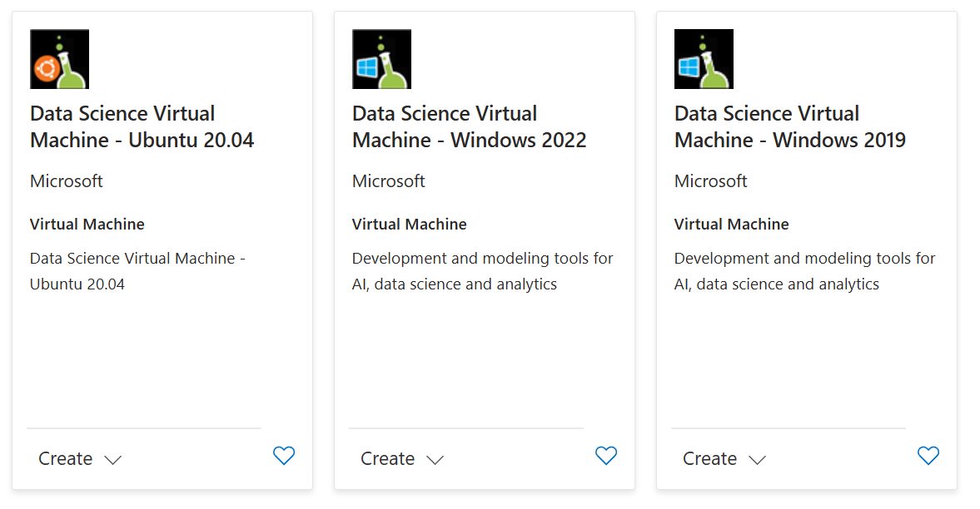
Data Science Virtual Machine
A virtual machine that comes with lots of data science-relevant software preinstalled.
Programming languages: Python, R, Julia
IDEs: Jupyter, RStudio, VS Code
ML/DL frameworks: Scikit-Learn, PyTorch, Tensorflow
Other software: Azure Storage Explorer, Azure CLI, Database drivers, Office, Power BI, Git
Available with Ubuntu or Windows OS

Slide 7
Azure AI Services
Formerly called “Cognitive Services”, AI Services is a set of APIs that serve state-of-the-art models for various tasks. This includes computer vision, NLP, Open AI LLMs, etc.
https://azure.microsoft.com/en-us/products/ai-services

Slide 8
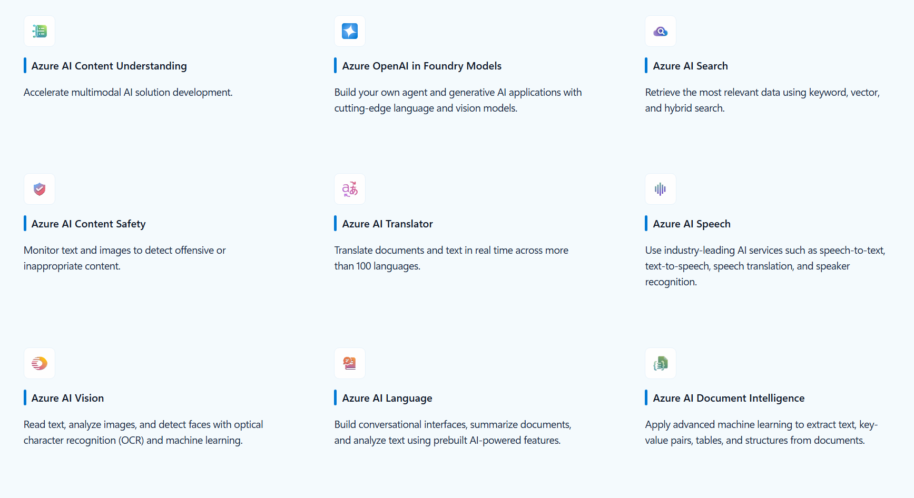
Azure AI Services
Formerly called “Cognitive Services”, AI Services is a set of APIs that serve state-of-the-art models for various tasks. This includes computer vision, NLP, Open AI LLMs, etc.
https://azure.microsoft.com/en-us/products/ai-services

Slide 9
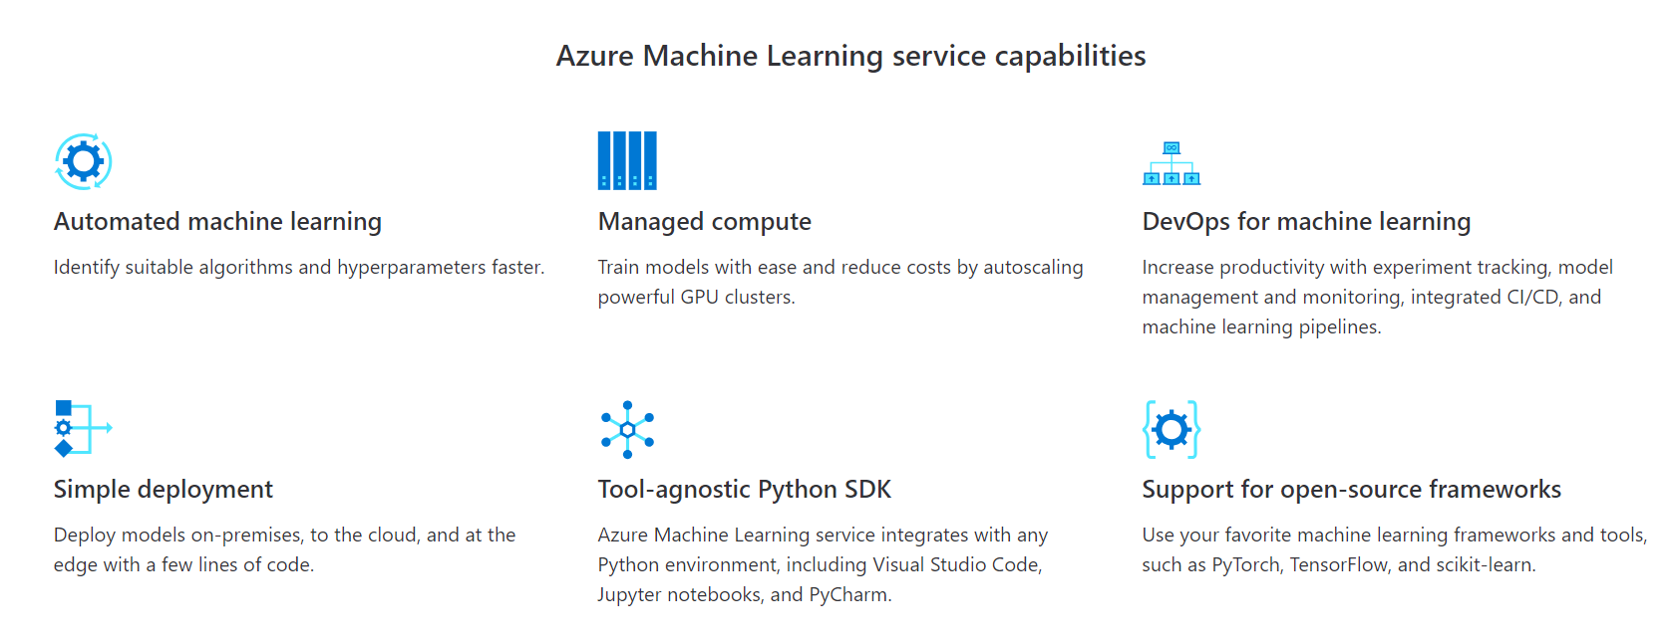
Azure Machine Learning Studio
Simplify and accelerate the building, training, and deployment of your machine learning models. Use automated machine learning to identify suitable algorithms and tune hyperparameters faster. Improve productivity and reduce costs with autoscaling compute and DevOps for machine learning. Seamlessly deploy to the cloud and the edge with one click.
https://azure.microsoft.com/en-us/services/machine-learning-service/

Slide 10
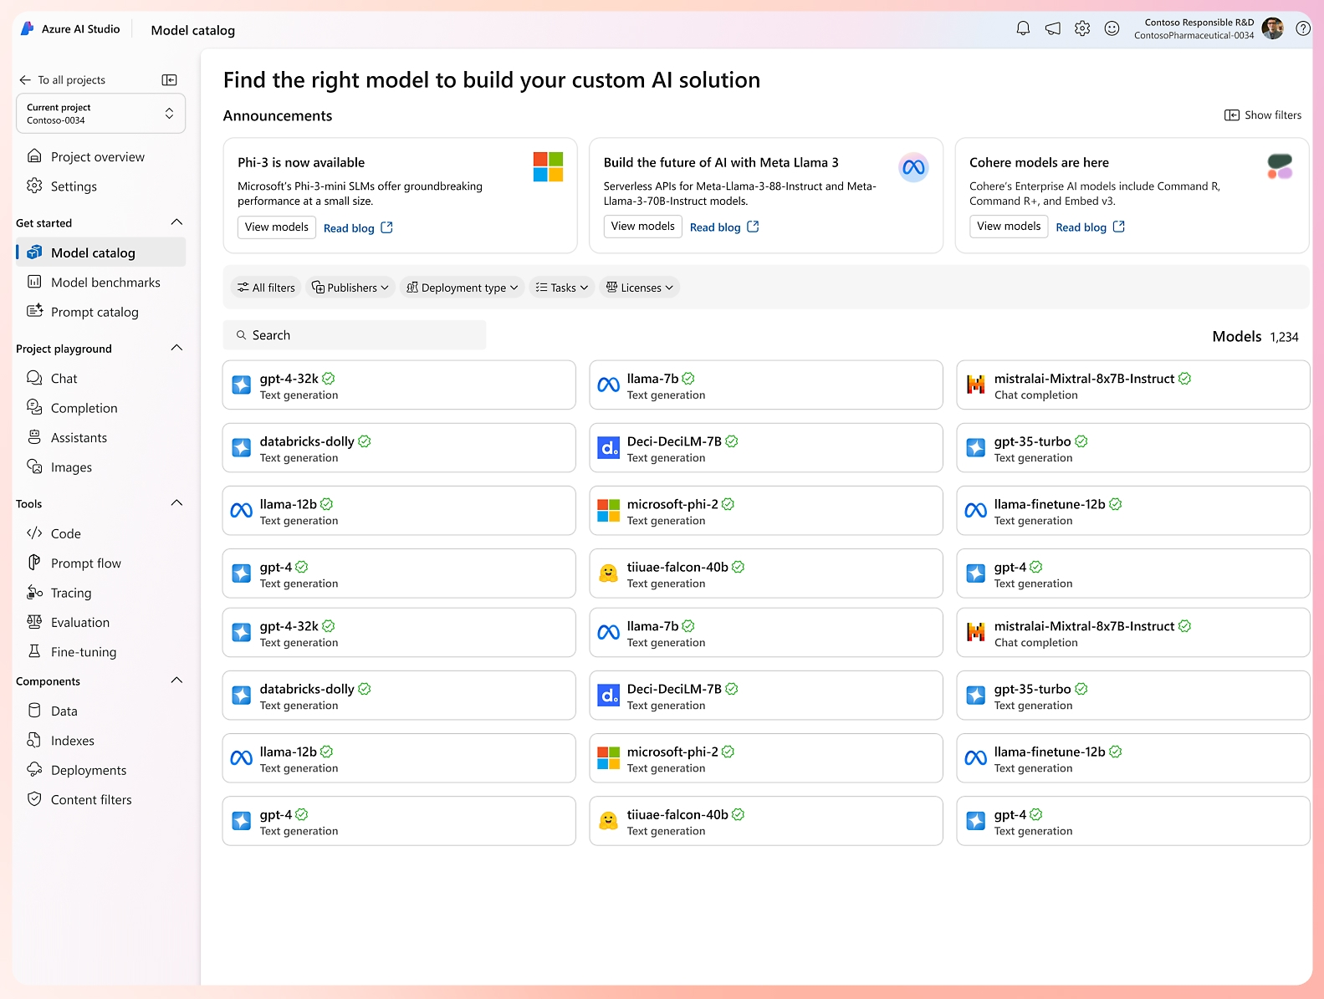
Azure AI Foundry
The “generative AI development hub”
Allows you to test and deploy various models, including LLMs and image models
Open-source, OpenAI, and others
https://ai.azure.com/

Slide 11
Automated Machine Learning (When you’re too lazy busy to do it yourself…)

Slide 12
AutoML
Classification | Regression & Time Series Forecasting
Logistic Regression | Elastic Net
Light GBM | Light GBM
Gradient Boosting | Gradient Boosting
Decision Tree | Decision Tree
K Nearest Neighbors | K Nearest Neighbors
Linear SVC | LARS Lasso
C-Support Vector Classification (SVC) | Stochastic Gradient Descent (SGD)
Random Forest | Random Forest
Extremely Randomized Trees | Extremely Randomized Trees
XGboost | XGboost
DNN Classifier | DNN Regressor
DNN Linear Classifier | Linear Regressor
Naive Bayes
Stochastic Gradient Descent (SGD)
Automatically test various algorithms, hyperparameters, and scaling techniques
Three Experiment Types:
Classification
Regression
Forecasting
Steps:
Preprocessing & Scaling
Featurization
Cross-Validation
Ensembling
https://docs.microsoft.com/en-us/azure/machine-learning/service/how-to-configure-auto-train

Slide 13
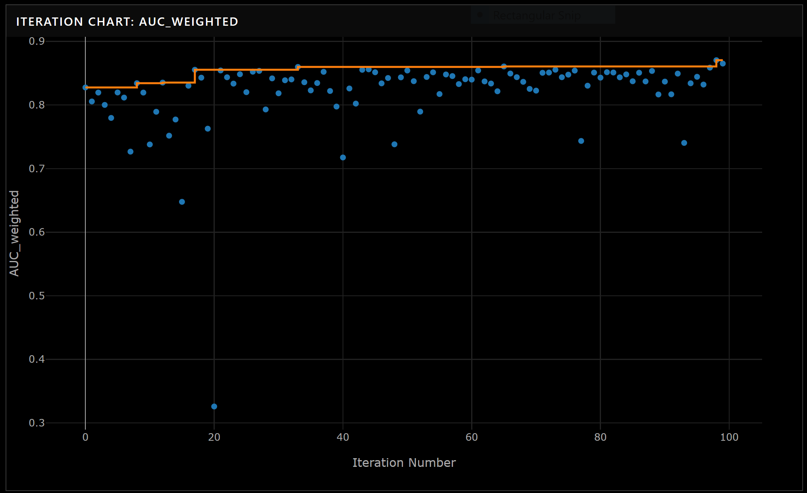
Picking the Best Model
Picks a best model(s) based on a Primary Metric
In Classification Problems:
Accuracy, Weighted AUC, Average Weighted Precision Score, Normalized Macro Recall, Weighted Precision Score
In Regression/Forecasting Problems:
Spearman Correlation, Normalized RMSE, R², Normalized MAE
https://docs.microsoft.com/en-us/azure/machine-learning/service/how-to-understand-automated-ml

Slide 14
Tracking ML Experiments: Two Ways
https://docs.microsoft.com/en-us/azure/machine-learning/how-to-train-scikit-learn
Train Inside the Compute Instance,
Track Externally in Azure ML
Train Externally in a Compute Cluster,
Track Externally in Azure ML
## Connect to Workspace
ws = Workspace.from_config()
## Create Experiment
experiment = Experiment(workspace = ws, name = '<group>_diabetes')
## Create Run
run = experiment.start_logging(outputs=None, snapshot_directory=".", display_name="run_name")
<ML STUFF HERE>
## Log Metrics
run.log('auc_train', 0.85)
run.log('auc_test', 0.82)
run.complete()
## Connect to Workspace
ws = Workspace.from_config()
## Create Experiment
experiment = Experiment(workspace = ws, name = '<group>_diabetes')
<ML STUFF in a train.py SCRIPT>
## Connect to Compute Target (Optional)
training_cluster = ComputeTarget(workspace=ws, name=cluster_name)
## Create Environment for sklearn
sklearn_env = Environment("sklearn-env")
## Create a script config
script_config = ScriptRunConfig(source_directory='.',
script='train.py',
arguments = [],
compute_target=training_cluster,
environment=sklearn_env)
## Submit Experiment
run = experiment.submit(config = script_config)

Slide 15

MLOps Lifecycle in Azure Machine Learning
The ML experiment is defined
ML models are trained under the experiment (using a registered dataset) and, for each, a Run is defined
The Data Lake is defined as a Datastore
A file from the Datastore is registered as a Data Asset and versioned
The best model is registered and versioned
The registered model is deployed as a webservice

Slide 16
Machine Learning Lab Assignment
Part 1: Train and Deploy an AutoML Model in Azure Machine Learning Studio as an API.
Find a ML dataset and upload it to the data lake
Using either the Python SDK or GUI, create an AutoML experiment and train a series of models
Evaluate the models and pick the best one
Deploy it as an API endpoint
Part 2: Play with an Azure OpenAI model and compare it to an open-source model.
Using the class Azure AI Foundry, play with a deployed OpenAI model, testing its performance and limitations
Pick an open-source model and play with it as well, testing its performance and limitations
Compare the two

Slide 17
Large Language Models, RAG, and Prompt Flows

Slide 18
What are Large Language Models?
LLMs are a type of neural network
that perform natural language processing by
generating text-based responses.
A Brief History
Early language models, like Seq2Seq from 2014, could make responses using “sequence transformation”.
In 2017, Google researchers released the paper “Attention Is All You Need” and released BERT in 2018.
OpenAI released GPT-1 in 2018. ChatGPT, based on GPT-3.5, was released in 2022.
Some Popular Examples
Microsoft Copilot, OpenAI’s GPT-4o, Meta’s Llama3.1, Anthropic’s Claude, and Mistral’s various models.
Differ in:
Open-source vs. closed-data vs. proprietary
Size, capabilities, and purpose
What’s getting better?
Context windows: How large of an input can it reference
Model size: run on phones or giant GPUs
Tunable models for your use case using your internal data
What’s getting worse?
Data privacy concerns (misuse of data for training)
Misuse of models (plagiarism, etc.)
AI-generated content being retrained upon

Slide 19
How Do LLMs Work?
Slides
(100%)
LLMs use a huge amount of input text to train a model to predict the next word in a sentence given some input prompt.
Input: some prompt
“Write a haiku about presenting
at an Alzheimer’s conference.”
Output: some probabilistically likely set of words in a readable order
“Slides flicker, hearts speak,
Memories fade, but hope shines—
Mind's echo, we seek.”
shift
(25%)
glow
(20%)
shine
(15%)
flicker
(30%)
move
(10%)
souls
(20%)
hearts
(40%)
eyes
(15%)
minds
(20%)
thoughts
(10%)
love
(15%)
skip
(10%)
beat
(20%)
pump
(20%)
speak
(25%)
Memories
(80%)

Slide 20
How Are They Trained?
As more training examples flow into the algorithm, the weights of the model get updated.
Using 10s of terabytes of curated text data (web content, books, etc.), LLMs are trained by feeding in sentences.
These get tokenized (split into parts and indexed/“embedded”), then fed into the training process.
 | Hidden Layer Units
Vector | Unit 1 | Unit 2 | Unit 3 | Unit 4
_Have | 0.2 | -0.1 | 0.4 | 0.6
_you | -0.3 | 0.8 | 0.1 | -0.2
_joined | 0.5 | -0.4 | 0.2 | 0.3
I | -0.6 | 0.2 | 0.5 | -0.1
STA | -0.4 | 0.3 | 0.4 | 0.1
ART | -0.5 | 0.2 | 0.2 | -0.1
_yet | 0.1 | 0.3 | -0.2 | 0.4
? | 0.3 | -0.2 | 0.1 | -0.1
['Have you joined ISTAART yet?']
['Have', 'you', 'joined', 'ISTAART', ‘yet?']
['▁Have', '▁you', '▁joined', '▁I', 'STA', 'ART', '▁yet', '?']
*Example tokenization: XLNetTokenizer

Slide 21
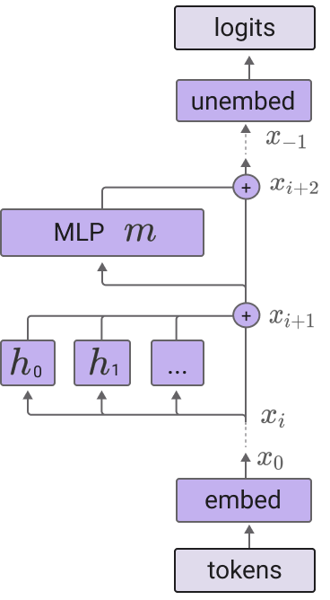
Transformers and Attention
⬅Convert back to tokens
In this talk I learned a lot about LLMs in class
⬅Neural network layers
(with weights)
 | In | this | talk | I | learned | a | lot | about | LLMs | in | class
In | 0.1 | 0.1 | 0.1 | 0.05 | 0.05 | 0.05 | 0.05 | 0.1 | 0.1 | 0.1 | 0.1
this | 0.1 | 0.1 | 0.1 | 0.05 | 0.05 | 0.05 | 0.05 | 0.1 | 0.1 | 0.1 | 0.1
talk | 0.1 | 0.1 | 0.1 | 0.05 | 0.05 | 0.05 | 0.05 | 0.1 | 0.1 | 0.1 | 0.1
I | 0.05 | 0.05 | 0.05 | 0.2 | 0.15 | 0.05 | 0.05 | 0.05 | 0.1 | 0.05 | 0.05
learned | 0.05 | 0.05 | 0.05 | 0.15 | 0.2 | 0.05 | 0.05 | 0.05 | 0.1 | 0.05 | 0.05
a | 0.05 | 0.05 | 0.05 | 0.05 | 0.05 | 0.2 | 0.15 | 0.05 | 0.1 | 0.05 | 0.05
lot | 0.05 | 0.05 | 0.05 | 0.05 | 0.05 | 0.15 | 0.2 | 0.05 | 0.1 | 0.05 | 0.05
about | 0.1 | 0.1 | 0.1 | 0.05 | 0.05 | 0.05 | 0.05 | 0.1 | 0.1 | 0.1 | 0.1
LLMs | 0.1 | 0.1 | 0.1 | 0.1 | 0.1 | 0.1 | 0.1 | 0.1 | 0.1 | 0.05 | 0.05
in | 0.1 | 0.1 | 0.1 | 0.05 | 0.05 | 0.05 | 0.05 | 0.1 | 0.1 | 0.1 | 0.1
class | 0.1 | 0.1 | 0.1 | 0.05 | 0.05 | 0.05 | 0.05 | 0.1 | 0.05 | 0.1 | 0.1
⬅Attention heads
⬅Input tokens
Source: https://transformer-circuits.pub/2021/framework

Slide 22
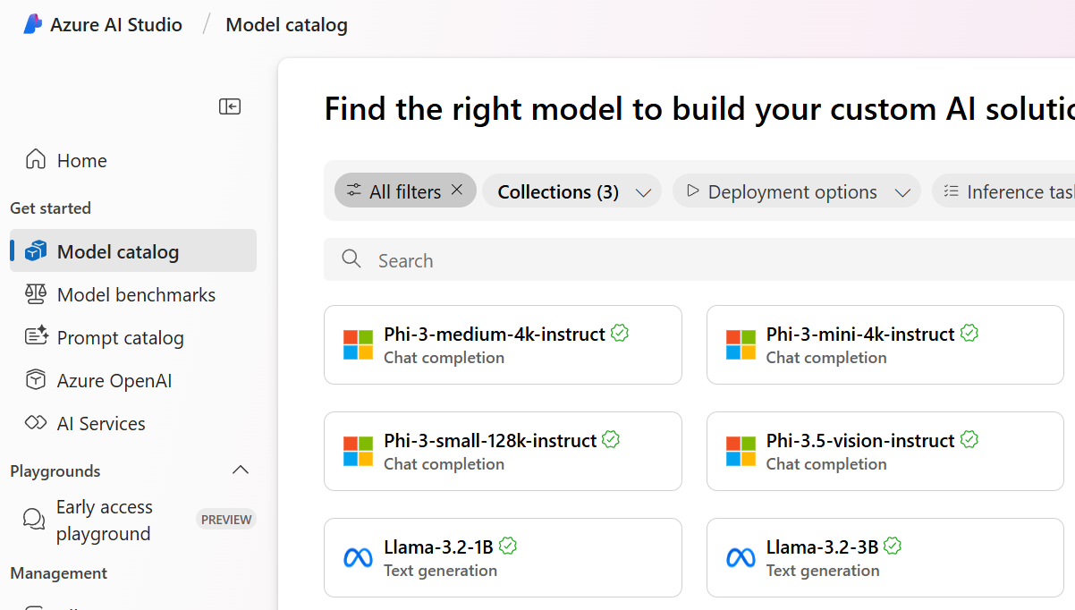
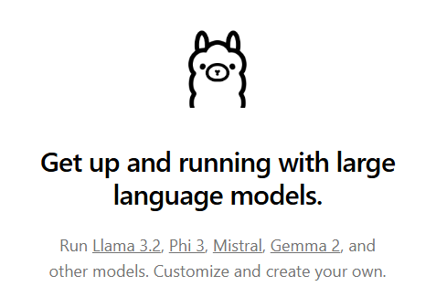
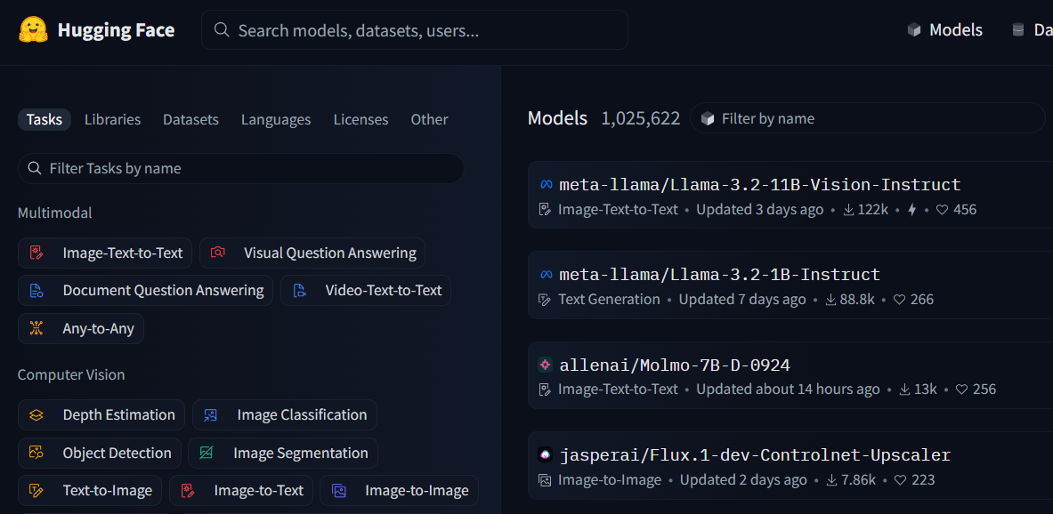

Places to Play with Open-Source Models
Azure AI Foundry - Model Catalog
https://ai.azure.com/explore/models
Hugging Face Models
https://huggingface.co/models
Ollama
https://ollama.com/
Foundry Local
https://learn.microsoft.com/en-us/azure/ai-foundry/foundry-local/get-started

Slide 23
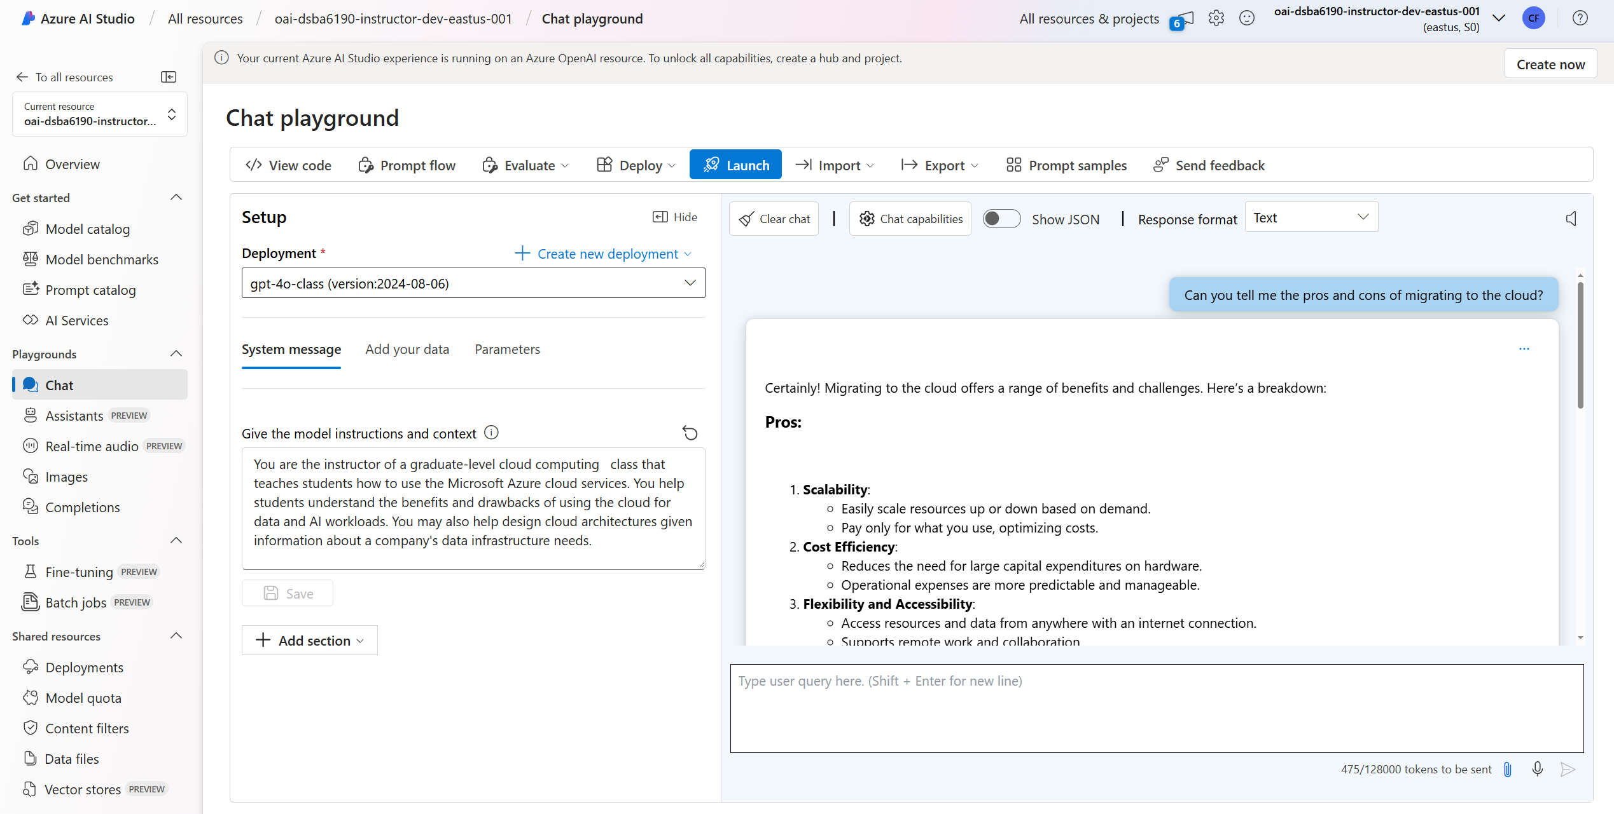
Chat Playground
Easily chat with various OpenAI models
Test system messages, which guide the model’s behavior
Connect to your own data from Blob Storage, URLs, flat files, etc.
Tweak parameters to see how they affect model outputs

Slide 24
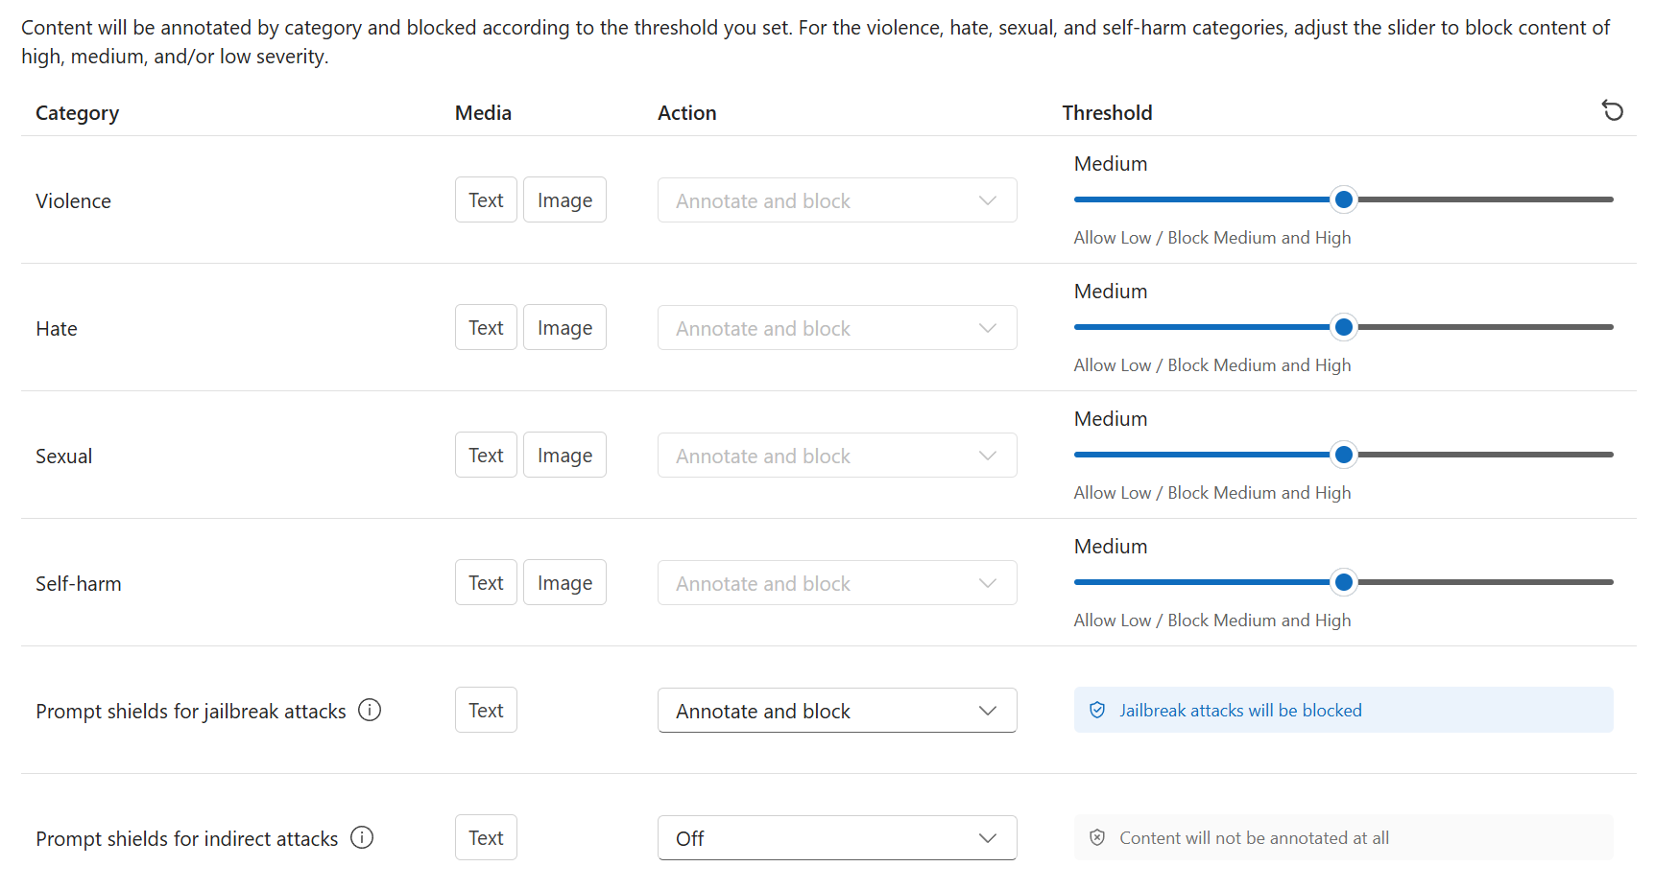
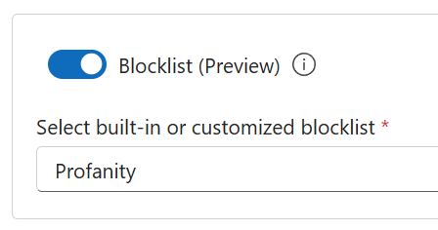
Content Filters
Can filter
Inputs
+
outputs
Can limit specific words or phrases

Slide 25
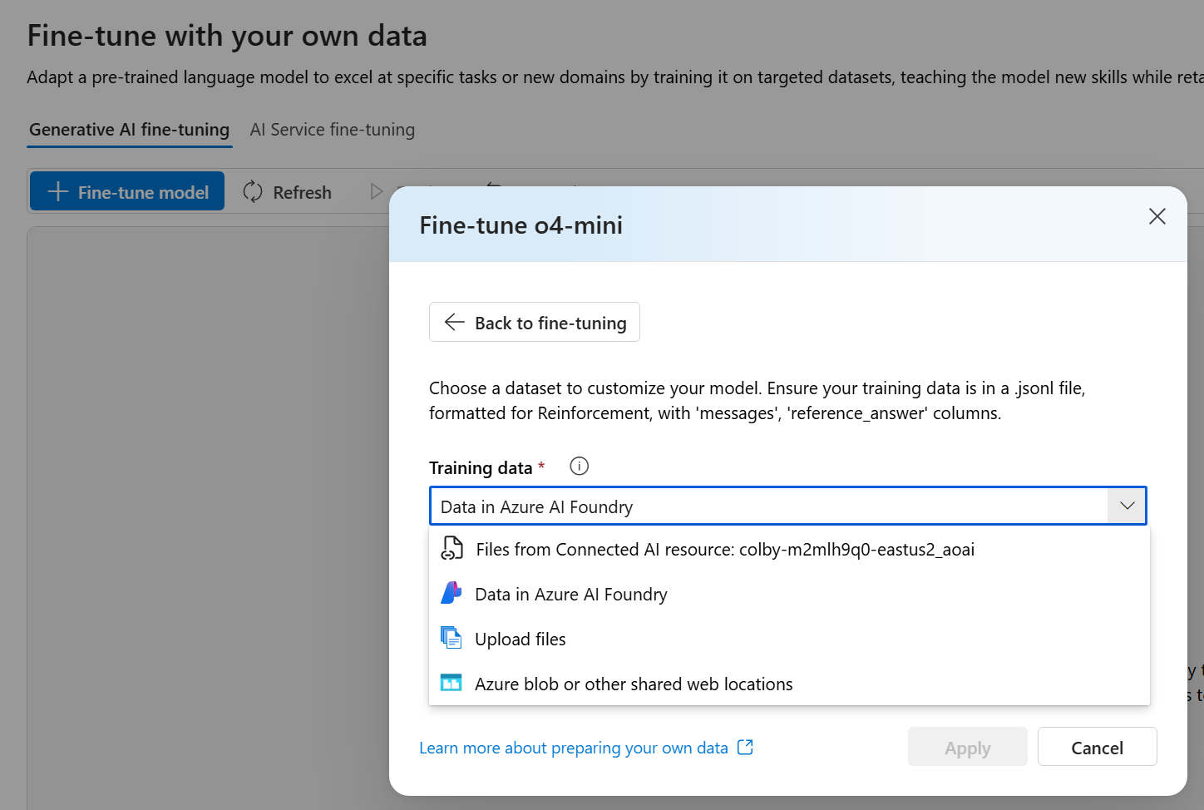
Fine-Tuning
In Foundry, we can use specially-formatted data in .jsonl files to fine-tune certain models (e.g. GPT o4) for specific purposes.
Supervised Fine Tuning (SFT): supported by all non-reasoning models.
Direct Preference Optimization (Preview) (DPO): supported by GPT-4o.
Reinforcement Fine Tuning (Preview) (RFT): supported by reasoning models, like o4-mini.
You can control the batch size, learning rate multiplier, and # epochs (and reasoning effort for some models).
{"messages": [{"role": "system", "content": "Clippy is a factual chatbot that is also sarcastic."}, {"role": "user", "content": "Who discovered Antarctica?"}, {"role": "assistant", "content": "Some chaps named Fabian Gottlieb von Bellingshausen and Mikhail Lazarev, as if they don't teach that in every school!"}]}

Slide 26








RAG: Retrieval Augmented Generation
Enhance the capabilities of an LLM by augmenting its response using connected data sources.
This enables LLMs to generate more accurate and contextually-relevant responses.
Preprocessing…
Documents
Indexer
Knowledgebase
Retrieved
Documents
Retrieval
System
Generator
CosmosDB
(likely MongoDB)
Azure AI
Search
Azure ML
Studio
Augmented
Response
User
Query

Slide 27
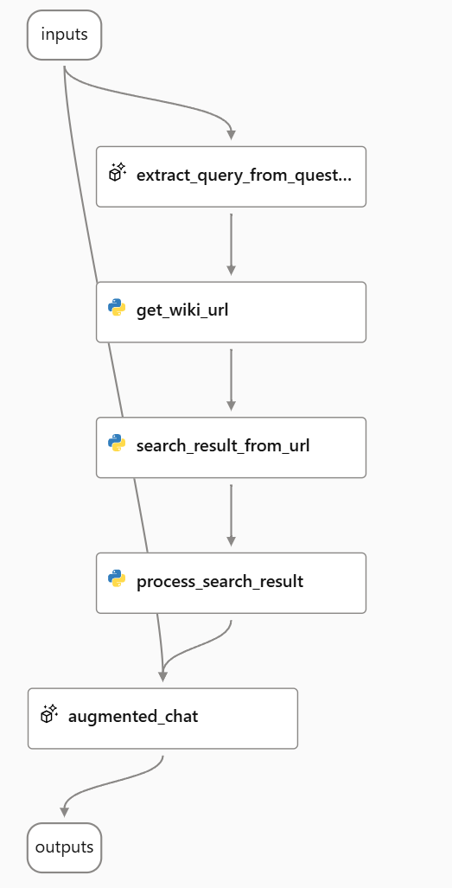
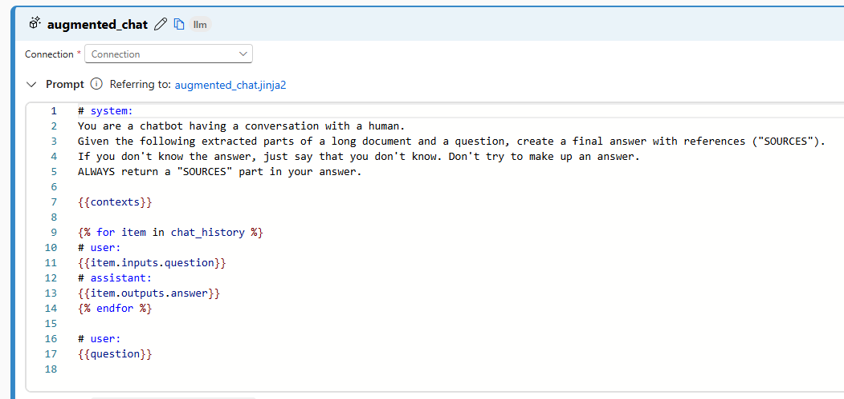
Prompt Flows
Allow for you to specify custom logic on how your user’s query gets handled in an LLM input.
Execute custom code to better parse/prepare the input
Can call specific data sources to augment the response
Refine the response to meet your specific output requirements
“Chat with Wikipedia” Example

Slide 28
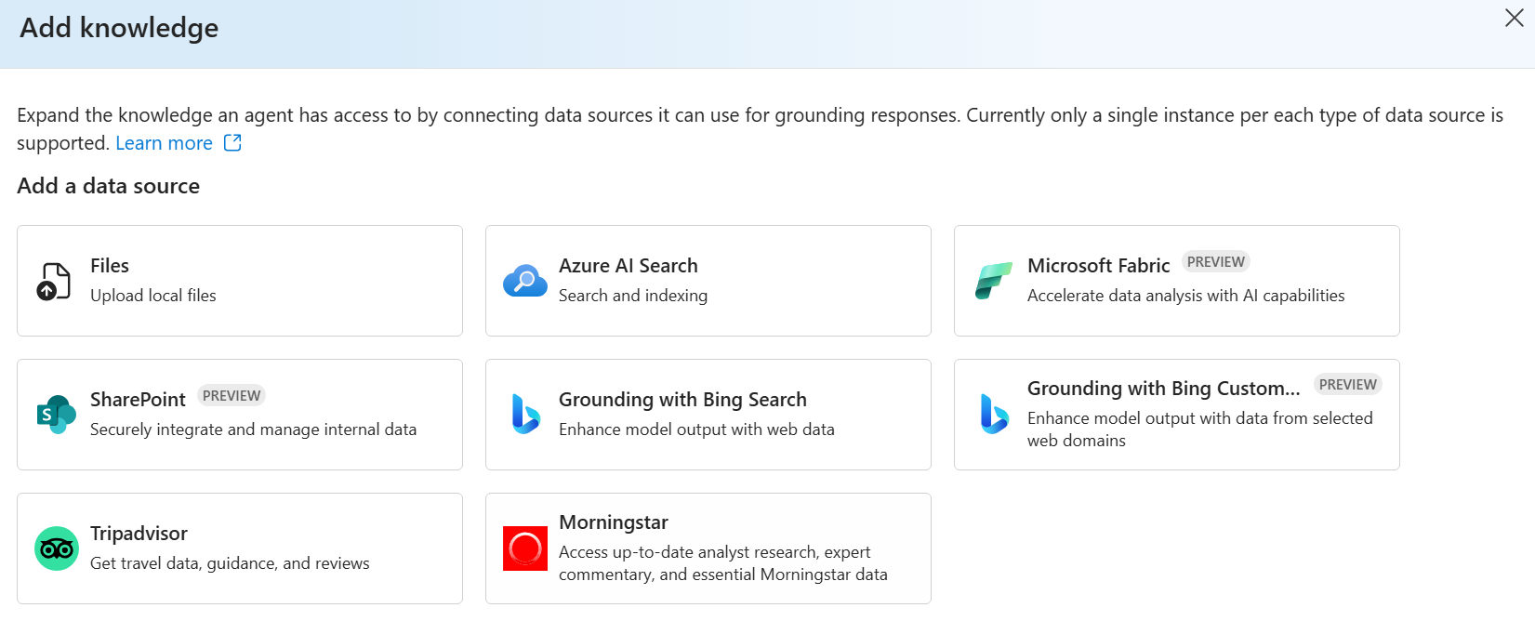
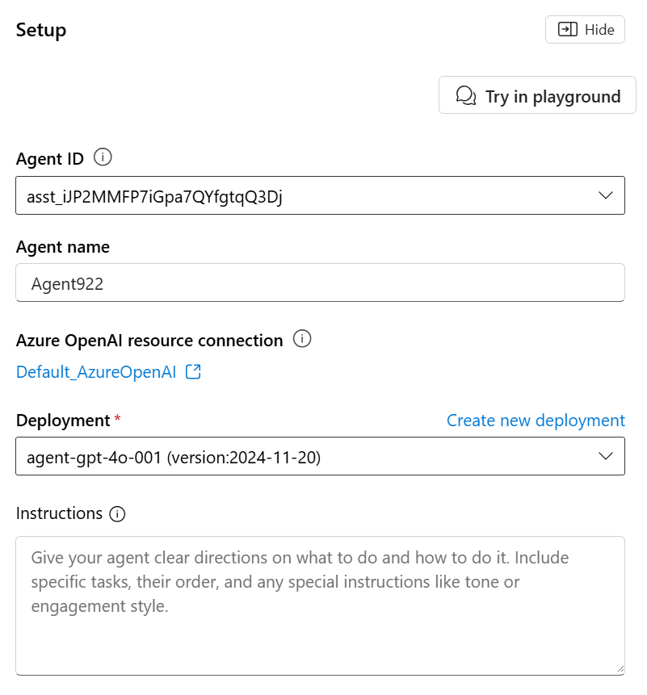
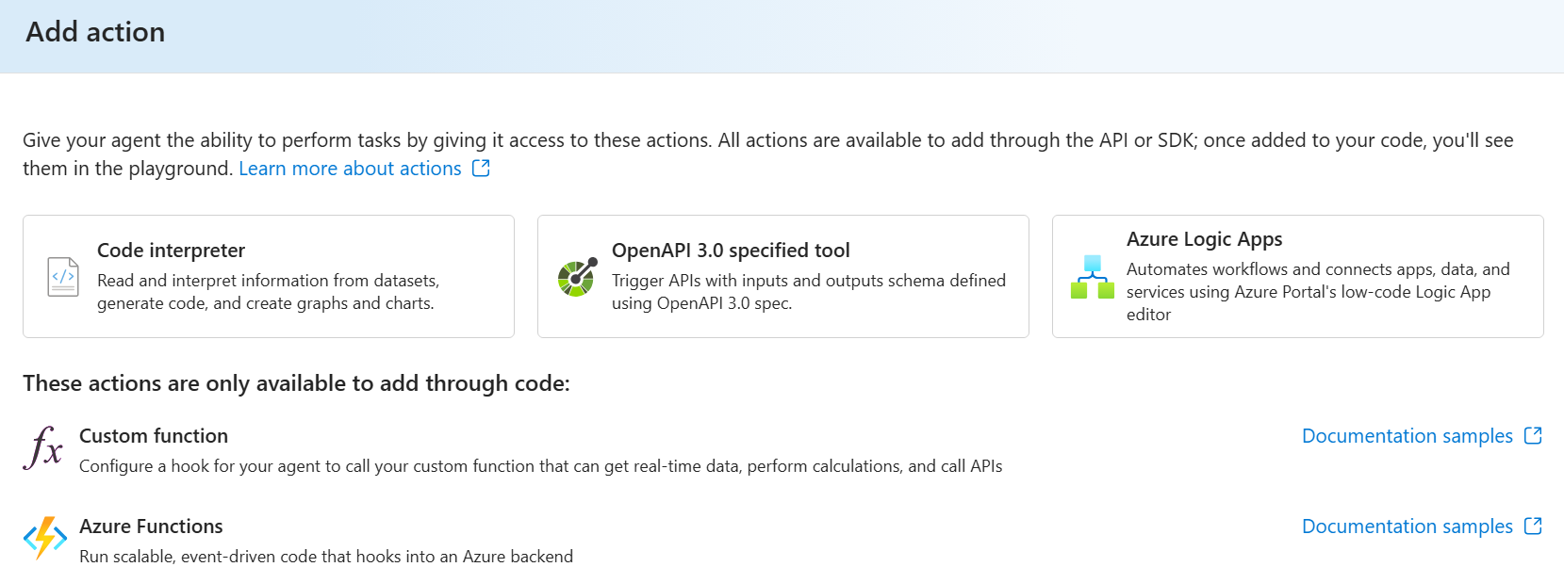
Agents
A newer way of handling the connection between an AI model, data resources, and other tools to perform tasks.

Slide 29
MLOps and Model Deployment

Slide 30
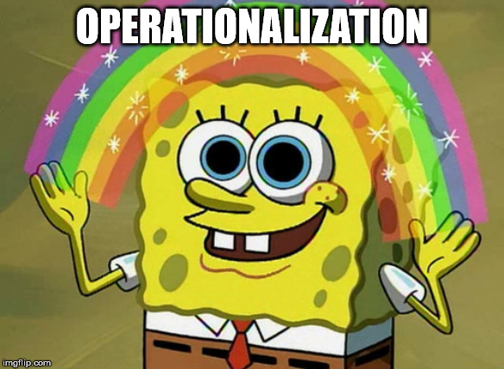
“Now that my we have an ML model that they’re happy with, how do we go about using it in production?”

Slide 31
Deployment Options
Batch
For when you have a larger set of data that can be scored all at once.
Scheduled at a specific time or triggered based on the presence of new data.
“Every morning at 8am, score all of the data from the day before in bulk.”
Realtime
For when you have data to score that comes in sporadically.
Usually deployed as an API endpoint that can be called.
“As new data comes in, score each record one at a time.”

Slide 32
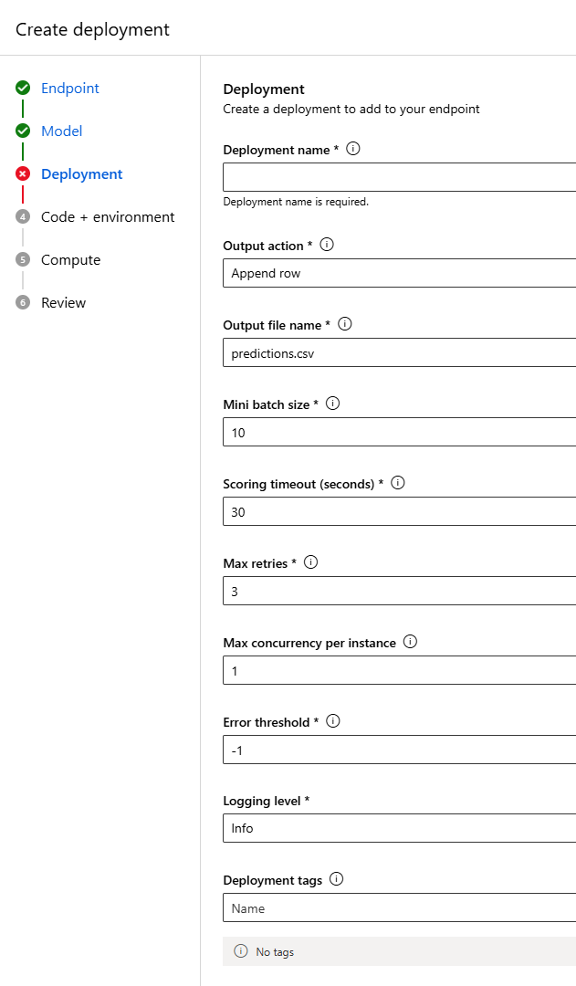



Batch Scoring
Databricks Option 1:
Databricks + Data Factory as the Orchestrator
Azure ML Option:
As a Batch Endpoint
with a Compute Cluster
Databrick Option 2:
Databricks Jobs

Slide 33
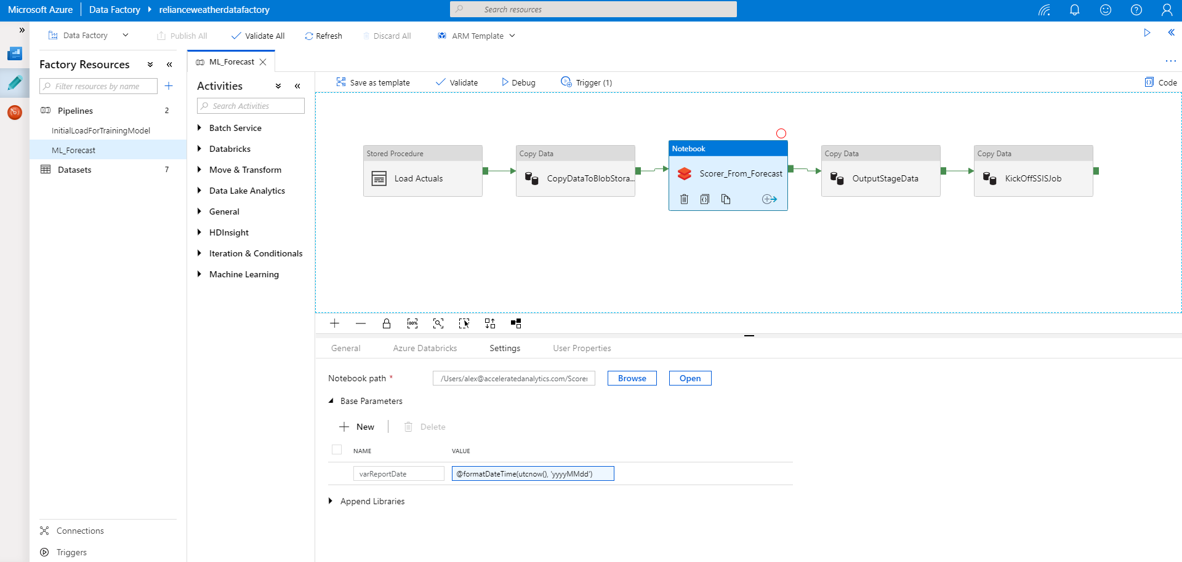
Databricks + Azure Data Factory

Slide 34
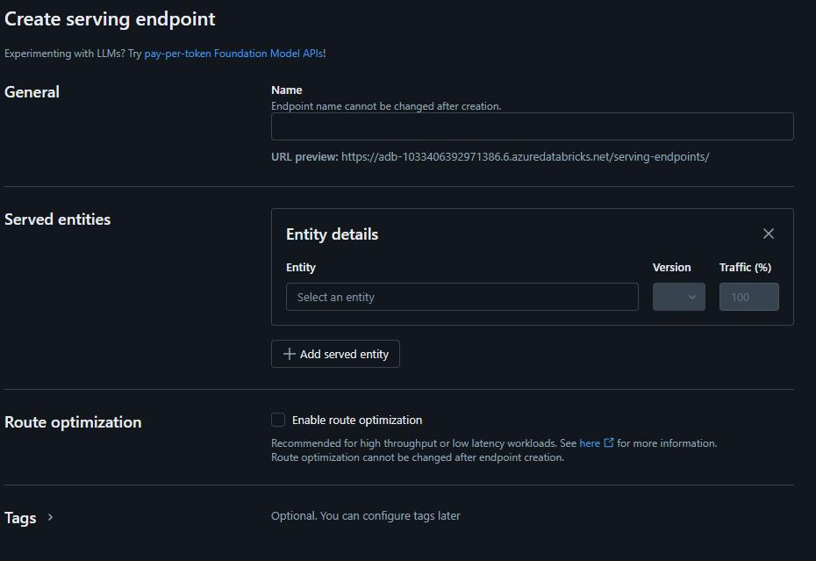
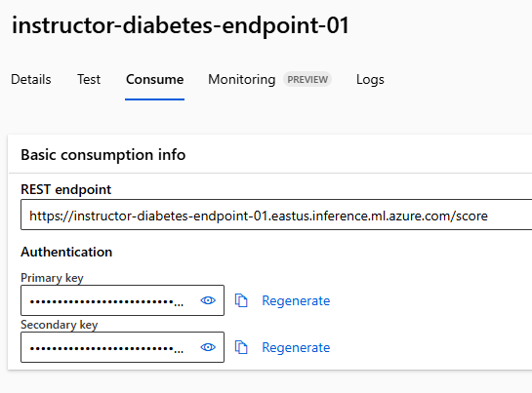



Realtime Scoring
Databricks Option:
Databricks Model
Serving
Azure ML Option 1:
As a Real-time Endpoint
with a Virtual Machine
Azure ML Option 2:
As a Serverless Endpoint
(pay-as-you-score)
Other Options:
Azure Functions
Azure Container
Instances
Azure Kubernetes
Service

Slide 35
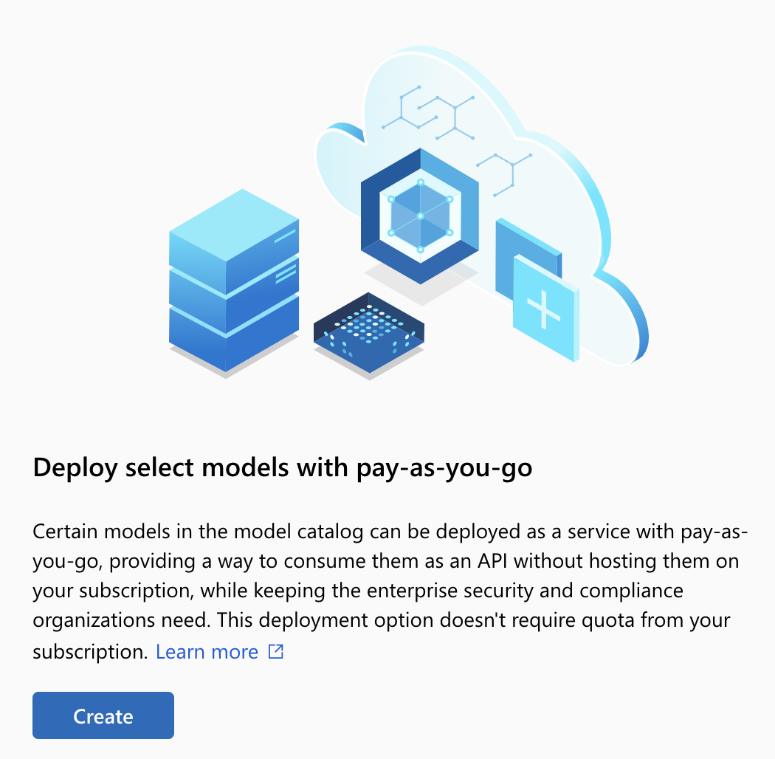
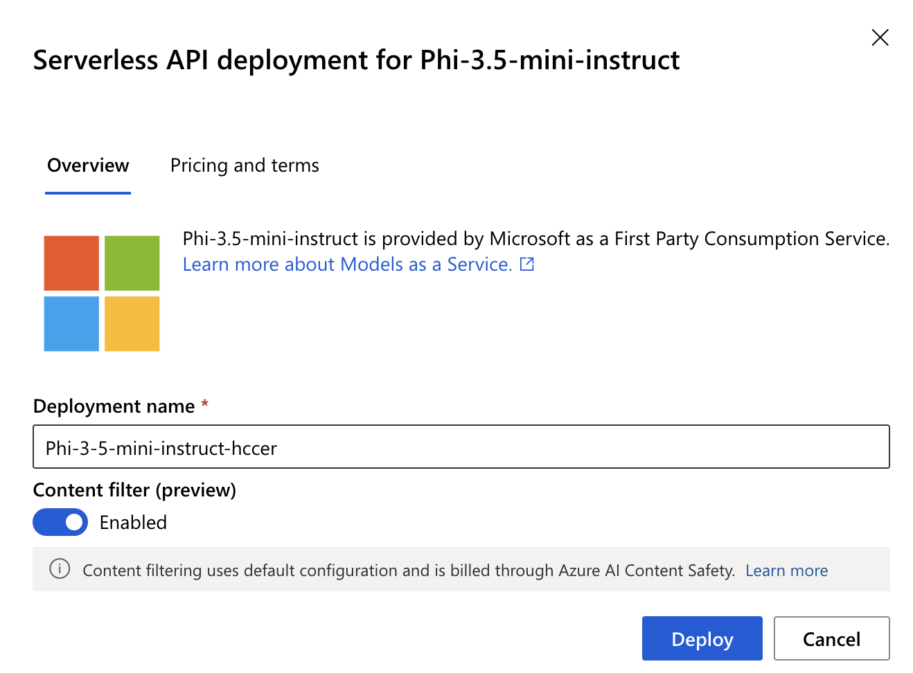
Serverless Endpoints
For certain hosted models, you can deploy a serverless endpoint.
Pay-as-you-go pricing based on token usage.
Models | Context | Input (Per 1k tokens) | Output (Per 1k tokens)
Phi-4 | 128K | $0.000125 | $0.0005
Phi-4-mini | 128K | $0.000075 | $0.0003
Phi-4-multimodal, text and image | 128K | $0.00008 | $0.00032
Phi-4-multimodal, audio | 128K | $0.004 | $0.00032
Phi-4-mini-reasoning | 128K | $0.000075 | $0.0003
Phi-4-reasoning | 32K | $0.000125 | $0.0005
Phi-4-reasoning-plus | 32K | $0.000125 | $0.0005

Slide 36
Deep Learning + GPU Acceleration

Slide 37
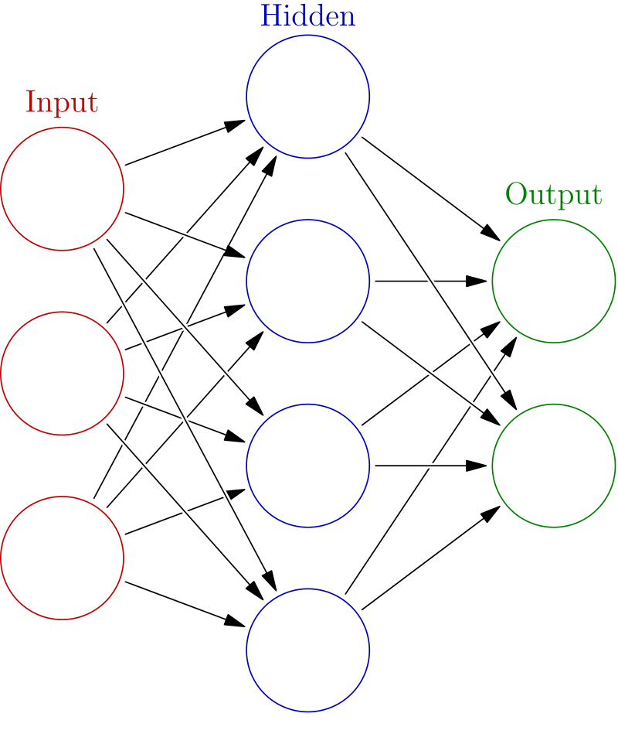
Overview of Neural Networks
Built using interconnected nodes in multiple layers
Layers:
Input:
The set of input features
Hidden:
Set of mathematical functions to compute activations
Output:
The predicted class or value
Connections:
Directional weights
Examples:
Recurrent Neural Networks
Useful for NLP
Convolutional Neural Networks
Useful in Image Recognition
Long Short-Term Memory
Useful for Time Series
…tons more
“Deep” just means there are multiple layers…
https://commons.wikimedia.org/w/index.php?title=File:Colored_neural_network.svg&oldid=279111871
16:07

Slide 38
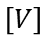
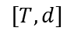
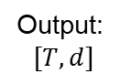
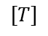
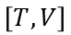
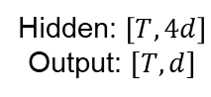
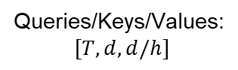
Example LLM Architecture
Input
h Layers
Output
Tokenization
Embedding
Attention
Heads
Multilayer Perceptron
Unembedding
Logits
Convert the input to tokens
Embed the tokens in the vector space
Give weights to the relationship between tokens
Expands and projects down
Projects hidden dimensions to vocabulary space
Final token probabilities
$$[T]$$
$$[T,d]$$
Queries/Keys/Values:
$[T,d, d/h]$
Hidden: $\left[T,4d\right]$
Output: $[T, d]$
$$\left[T,V\right]$$
$$\left[V\right]$$
Output:
$[T,d]$
Vocabulary size: 𝑉=30,000
Embedding dimension: 𝑑=768
Number of tokens in sequence (context): 𝑇=512
Number of attention heads: ℎ=12
Feedforward layer dimension (hidden size): 4×𝑑=3072
27:13

Slide 39
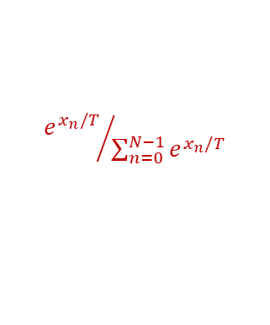
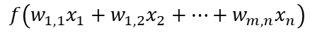

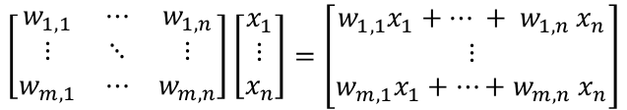
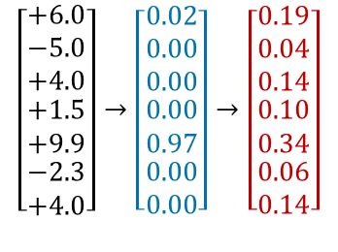
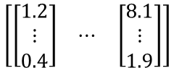
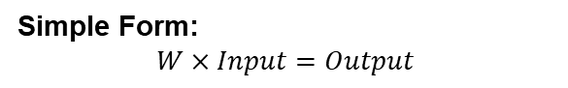

Matrix Multiplication in LLMs
Context window:
$$\left[\begin{matrix}\left[\begin{matrix}1.2 \\ ⋮ \\ 0.4\end{matrix}\right] & ⋯ & \left[\begin{matrix}8.1 \\ ⋮ \\ 1.9\end{matrix}\right]\end{matrix}\right]$$
GPT-3 has about 175B parameters
Vocabulary tokens: 50,257
Embedding dimensions: 12,288
Context window: 2,048
Matrices: 27,938
In the most basic form, we get the output by multiplying the weight matrices by the inputs.
12,288 d_embed
2,048 n_context
Softmax with Temperature:
Softmax transforms the output to sum to 1. With temperature, this “flattens” the output probability distribution.
$${e^{x_{n}/T}}/{\sum_{n=0}^{N−1}{e^{x_{n}/T}}}$$
$$\left[\begin{matrix}\begin{matrix}+6.0 \\ −5.0 \\ +4.0\end{matrix} \\ \begin{matrix}+1.5 \\ +9.9 \\ \begin{matrix}−2.3 \\ +4.0\end{matrix}\end{matrix}\end{matrix}\right]→\left[\begin{matrix}\begin{matrix}0.02 \\ 0.00 \\ 0.00\end{matrix} \\ \begin{matrix}0.00 \\ 0.97 \\ \begin{matrix}0.00 \\ 0.00\end{matrix}\end{matrix}\end{matrix}\right]→\left[\begin{matrix}\begin{matrix}0.19 \\ 0.04 \\ 0.14\end{matrix} \\ \begin{matrix}0.10 \\ 0.34 \\ \begin{matrix}0.06 \\ 0.14\end{matrix}\end{matrix}\end{matrix}\right]$$
Simple Form:
$$W×Input=Output$$
$$\left[\begin{matrix}w_{1,1} & ⋯ & w_{1,n} \\ ⋮ & ⋱ & ⋮ \\ w_{m,1} & ⋯ & w_{m,n}\end{matrix}\right]\left[\begin{matrix}x_{1} \\ ⋮ \\ x_{n}\end{matrix}\right]=\left[\begin{matrix}w_{1,1}x_{1}+{⋯ + w}_{1,n}x_{n} \\ ⋮ \\ w_{m,1}x_{1}+⋯{+ w}_{m,n}x_{n}\end{matrix}\right]$$
$$\text{softmax}$$
$$T=6.72$$
$$f\left(w_{1,1}x_{1}+w_{1,2}x_{2}+…+w_{m,n}x_{n}\right)$$

Slide 40
GPT-3 175B Configuration
Part | Matrix Dimensions | Weights
Embedding | 12,288 d_embed × 50,257 n_vocab | 617,558,016
Key | 128 d_query × 12,288 d_embed × 96 n_heads × 96 n_layers | 14,495,514,624
Query | 128 d_query × 12,288 d_embed × 96 n_heads × 96 n_layers | 14,495,514,624
Value | 128 d_value × 12,288 d_embed × 96 n_heads × 96 n_layers | 14,495,514,624
Output | 12,288 d_embed × 128 d_value × 96 n_heads × 96 n_layers | 14,495,514,624
Up-projection | 49,152 n_neurons × 12,288 d_embed × 96 n_layers | 57,982,058,496
Down-projection | 12,288 d_embed × 49,152 n_neurons × 96 n_layers | 57,982,058,496
Unembedding | 50,257 n_vocab × 12,288 d_embed | 617,558,016
Total | 27,938 Matrices | 175,181,291,520
Source: https://www.youtube.com/watch?v=wjZofJX0v4M

Slide 41
GPT Model Sizes
Model | Release Year | Parameter Count | Notes
GPT-1 | 2018 | 117M | Initial model, established Transformer architecture.
GPT-2 | 2019 | 1.5B | Significant increase in size; better coherence in generation.
GPT-3 / 3.5 | 2020 / 2022 | 175B | Redefined language models with few-shot and zero-shot learning capabilities.
GPT-4 / 4o | 2023 / 2024 | 1.8T | Uses a Mixture-of-Experts (MoE) architecture; includes multimodality (text and images). “o” means “Omni” model, integrates text, audio, image, and video; known for speed and efficiency.
GPT-4o mini | 2024 | 8B | A smaller, more cost-effective version of GPT-4o.
GPT-5 series | 2025 | ?? Likely the same as GPT-4 | Advanced reasoning capabilities, offering excellent performance across various tasks, agentic support.

Slide 42
Types of Processors (Well, the ones relevant to ML/DL/AI)
Central Processing Unit
1-128 Cores
up to ~9GHz
Single precision (32-bit), Double precision (64-bit) and possibly Extended precision (128-bit)
Graphics Processing Unit
100s-1000s of slower cores
~500-1800MHz
Field Programmable Gate Array
Reconfigurable chips to do a specific task – using programmable logic blocks
Tensor Processing Unit
Developed by Google (especially for use in TensorFlow).
High volume, low precision (8-bit)
Proprietary, but can be used on GCP or licensed
Useful in IoT/Edge scenarios
Single precision to Double precision

Slide 43
Types of Processors
(Well, the ones relevant to ML/DL/AI)
Central Processing Unit (CPU)
General-purpose processor for sequential tasks
Cores: 1–128 (consumer to high-end server CPUs)
Clock Speed: Up to ~9 GHz (boost speeds)
Precision: Single (32-bit), Double (64-bit), and Extended (128-bit)
Optimized for low-latency, complex control logic
Graphics Processing Unit (GPU)
Massively parallel processor for data-parallel workloads
Cores: Hundreds to thousands (SIMD/SIMT architecture)
Clock Speed: ~500 MHz–2.5 GHz
Precision: Single to Double precision (varies by model)
Ideal for graphics, simulation, and AI training
Tensor Processing Unit (TPU)
Developed by Google for machine learning workloads (especially TensorFlow)
Available via Google Cloud Platform (GCP) or through licensing
Optimized for matrix operations and inference
Precision: Low precision (typically 8-bit integer) for high throughput
Neural Processing Unit (NPU)
AI-specific accelerator integrated in mobile and edge devices
Optimized for deep learning inference (CNNs, transformers, etc.)
Balances energy efficiency and on-device intelligence
Found in smartphones, laptops, and embedded systems
Field-Programmable Gate Array (FPGA)
Reconfigurable hardware: custom logic implemented via programmable logic blocks
Optimized for deterministic, low-latency processing
Common in IoT, edge computing, and hardware acceleration scenarios
Can balance performance and power efficiency

Slide 44

ONNX
Open Neural Network Exchange
An open-source, standardized format for describing neural network models [*.onnx]
Helps in usability when the model object is framework-agnostic
Model Zoo: a place to publish your trained model for open, external use
import onnxruntime as ort
# Load the model and create InferenceSession
model_path = "path/to/your/onnx/model“
session = ort.InferenceSession(model_path)
# "Load and preprocess the input image inputTensor“
...
# Run inference
outputs = session.run(None, {"input": inputTensor})
print(outputs)

Slide 45

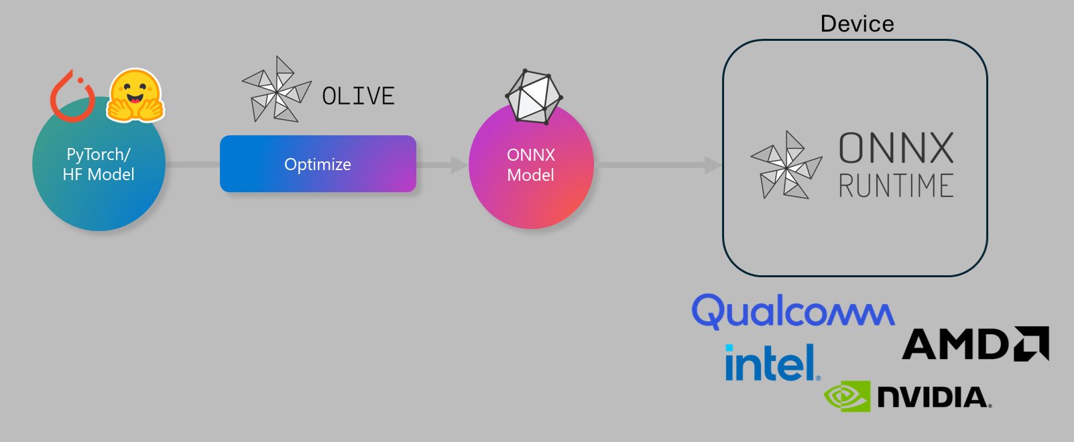
Olive
olive auto-opt \
--model_name_or_path meta-llama/Llama-3.2-1B-Instruct \
--trust_remote_code \
--output_path models/llama \
--device cpu \
--provider CPUExecutionProvider \
--use_ort_genai \
--precision int4 \
--log_level 1
Given a model and targeted hardware, Olive (abbreviation of ONNX LIVE) composes the best suitable optimization techniques to output the most efficient ONNX model(s).
Used for inferencing on the cloud or edge, while taking a set of constraints such as accuracy and latency into consideration.

Slide 46
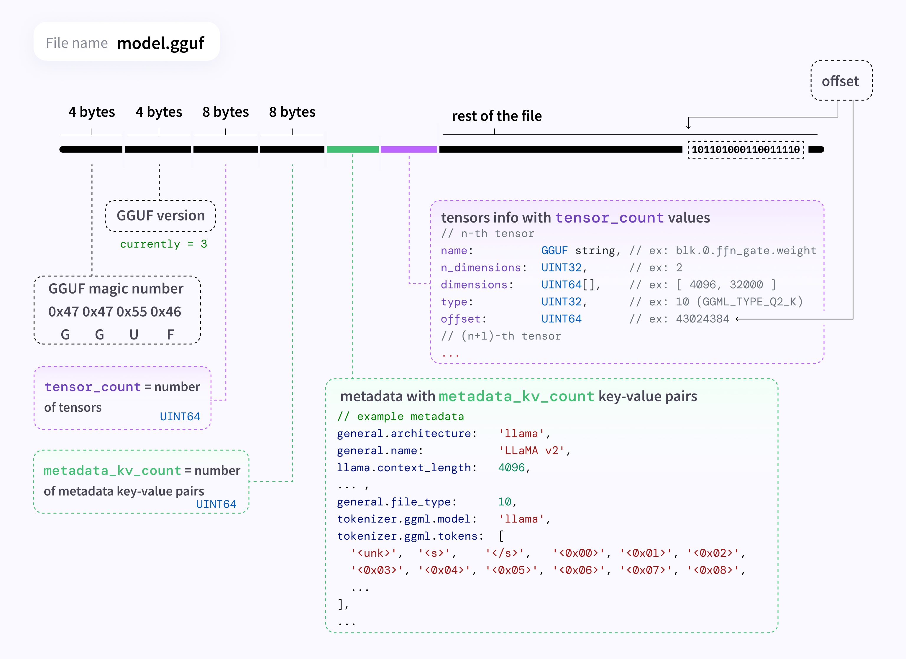
GGUF
“GPT-Generated Unified Format” is a binary file format for storing models for inferencing.
Single-file deployment for use in other tools.
Standardized format that houses LLM information (tokens, architecture, etc.)
Example in Ollama:
## in Modelfile
FROM ./vicuna-33b.Q4_0.gguf
## in Terminal
ollama create example -f Modelfile
ollama run example

Slide 47


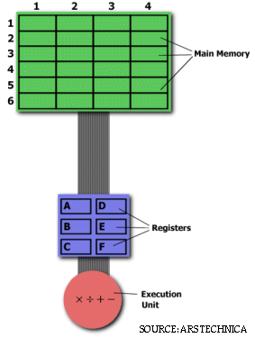
RISCy Business - ARM vs. x86 Processors
Intel and AMD processors use an x86 architecture and a CISC instruction set.
CISC: Complex Instruction Set Computer
CISC executes more complex instructions across multiple clock cycles.
Uses more memory to store the complex instructions
MULT 2:3, 5:2
ARM and RISC-V processors use a RISC instruction set.
RISC: Reduced Instruction Set Computer
RISC executes one instruction per clock cycle and uses simpler commands.
Uses the registers to store the intermediate results
LOAD A, 2:3 LOAD B, 5:2 PROD A, B STORE 2:3, A

Slide 48
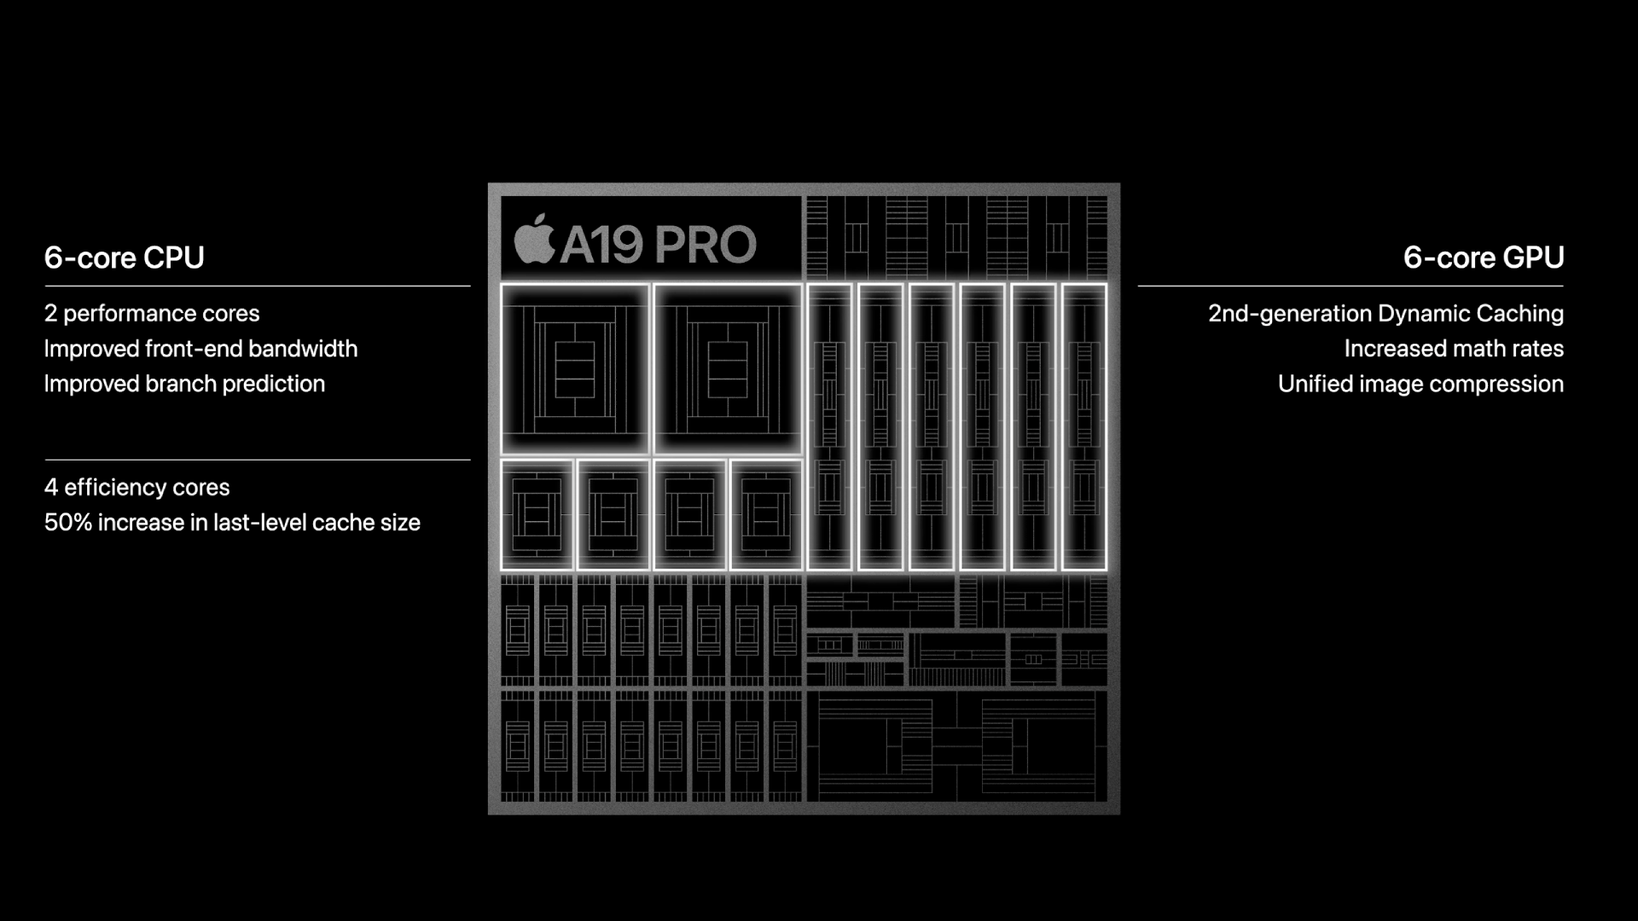
Apple Silicon
A custom-designed, blended chip in the M-series Macs that has CPU, GPU, and NPU cores.
For example, the M5 chip has:
10-core CPU with 4 performance cores and 6 efficiency cores
10-core GPU
16-core Neural Engine
Uses the ARMv9.4-A instruction set
To run traditional applications, macOS uses Rosetta 2, a translation layer that allows applications built for Intel-based Macs to run on Macs with Apple silicon

Slide 49
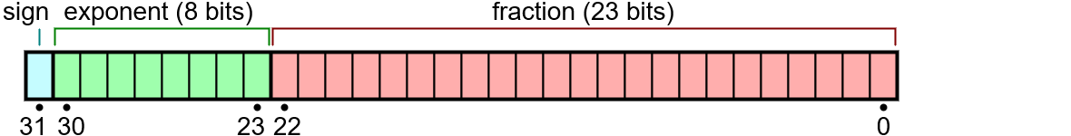
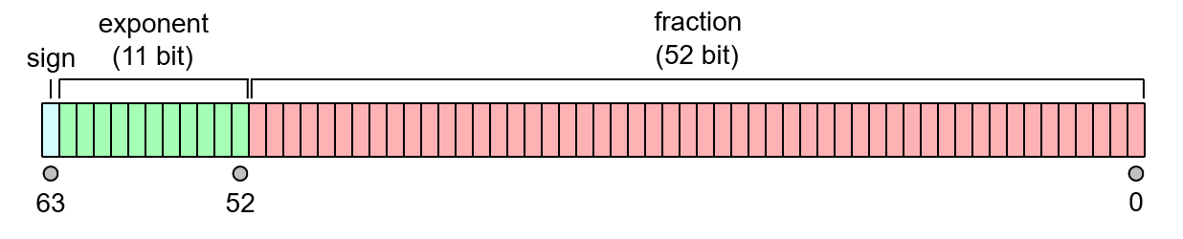
Precision, Precisely
Single Precision
Max Signed Integer Value: 2³¹ − 1 = 2,147,483,647
Max IEEE 754 Value: (2 − 2⁻²³) × 2¹²⁷ ≈ 3.4028235 × 10³⁸
Significant Digits: up to 9
Double Precision
Max Signed Integer Value: 2⁶³ − 1 = 9,223,372,036,854,775,807
Max IEEE 754 Value: (2 − 2⁻⁵²) × 2¹⁰²³ ≈ 1.7976931 × 10³⁰⁸
Significant Digits: up to 17
Binary32 Example
Input: 3.14159265358
Stored as: 3.1415927410125732421875
Error: 8.74325732421875E-8
Binary: 0 10000000 10010010000111111011011
Fun fact: the fraction part is called the “mantissa”
Binary64 Example
Input: 3.14159265358
Stored as: 3.1415926535800000607423498877324163913726806640625
Error: 6.07423498877324163913726806640625E-17
Binary: 0 10000000000 1001001000011111101101010100010000111101011011110100
https://evanw.github.io/float-toy/
Notes:
Fun fact: The “fraction” part of the IEEE Value is called the “Mantissa”

Slide 50


Whatever “Floats” your Boat ⛵
The data type that you use in a neural network has implications on the amount of memory and processing power needed to house and compute math operations
Less precision : less memory, faster processing
FP16 can only represent ±[5.97e-8, 65,504]
More precision : slower training, better performance?
FP32 can represent ±[1.4e-45, 3.4e38]
FP64 can represent ±[4.9e-324, 1.8e308]
Quantization can help after the fact to reduce model size. “Squish into the other data type.”
Source: https://blogs.nvidia.com/blog/2020/05/14/tensorfloat-32-precision-format/

Slide 51

Quantization
Data type | Accumulation | Math Power | Data size reduced
FP32 | FP32 | 1X | 1X
FP16 | FP16 | 8X | 2X
INT4 | INT32 | 16X | 4X
INT4 | INT32 | 32X | 8X
INT1 | INT32 | 128X | 32X
The technique to reduce the computational and memory costs of running inference by representing the weights and activations with low-precision data types like 8-bit integer (int8) instead of the usual 32-bit floating point (float32).
Reducing the number of bits means the model:
Uses less memory storage
Consumes less energy (in theory)
Operations like matrix multiplication can be performed much faster with integer arithmetic.
It also allows to run models on embedded devices, which sometimes only support integer data types, or have other hardware constraints.

Slide 52







Quantization (Example)
*In FP32, 0.37 is stored as: 0.37000000476837158203125
or 00111110101111010111000010100100 in binary.
Model Weight
Map the Scale
De-Quantize
$$w=0.37$$
$$S=\frac{max⁡(\left|w\right|)}{7}=\frac{1.0}{7}≈0.1429$$
$$\hat{w}=S×Q(w)=0.1429×3=0.4287$$
Stored as a 32-bit number (FP32)*
Let’s say the weights in this tensor range from [-1.0,+1.0]. Denominator is the max weight in the [-8,+7] quant range (so, 7).
4-bit Quantization
Reconstruct the original model weight
$$Q\left(w\right)=\text{round}\left(\frac{w}{S}\right)$$
Quantize the Value
Error
A 4-bit quantized value can represent 2⁴=16 discrete levels.
Where:
$S$ is the scale factor (how much one quantization level represents)
$Q(w)$is an integer between [-8,+7] (16 levels total).
$Q(w)∈\{−8,−7,−6,…,6,7\}$
$$Q\left(0.37\right)=\text{round}\left(\frac{0.37}{0.1429}\right)$$
$$=\text{round}\left(2.59\right)=3$$
$$\text{error}=w−\hat{w}$$
$$=0.37−0.4287=−0.0587$$
Integer representation (4-bit) is: 3
(binary: 0011)
The reconstructed model weight is off by -0.0587

Slide 53




CUDA and ROCm
CUDA
Developed by NVIDIA
“Compute Unified Device Architecture”
For use on Nvidia or CUDA-enabled GPUs (closed-source)
Parallelized functionality for linear algebra, sparse matrices, Fourier transforms, random numbers, solvers, graph processing, and more.
ROCm
Developed by AMD
For use GPUs for a variety of vendors (open-source)
Parallelized functionality for matrix algebra, linear algebra solvers, etc.
CUDA Processing Flow by Tosaka [CC BY 3.0 (https://creativecommons.org/licenses/by/3.0)]

Slide 54



Triton and Metal
Triton
Developed by OpenAI
For use on virtually any GPU
Technically a language and compiler (open-source)
Primitives for custom deep learning functionality
Metal/MLX
Developed by Apple
For use across Apple hardware (integrated M chips with both CPU and GPUs)
Metal was originally for gaming, but now has a backend for PyTorch
MLX supports local LLM fine-tuning and inferencing
“Triton makes it possible to reach peak hardware performance with relatively little effort; for example, it can be used to write FP16 matrix multiplication kernels that match the performance of cuBLAS—something that many GPU programmers can’t do—in under 25 lines of code. Our researchers have already used it to produce kernels that are up to 2x more efficient than equivalent Torch implementations, and we’re excited to work with the community to make GPU programming more accessible to everyone.”

Slide 55

In Closing…
Neural networks (especially LLMs) use large amounts of matrix multiplication to get the job done
Certain factors/decisions can impact the performance of the model (both training/tuning and inferencing)
Hardware: GPU vs. CPU
Core Quantity, Core Speed, Core Type
Architecture: x86, ARM
Precision: FP16, FP32, BFLOAT16
Technology: CUDA, ROCm, Metal
Framework: PyTorch, Tensorflow, MXNet
Network Architecture
Quantization, etc.

Slide 56
APPENDIX

Slide 57

https://azure.microsoft.com/en-us/solutions/architecture/information-discovery-with-deep-learning-and-nlp/

Slide 58

https://azure.microsoft.com/en-us/solutions/architecture/defect-prevention-with-predictive-maintenance/

Slide 59

https://docs.microsoft.com/en-us/azure/architecture/example-scenario/ai/predict-hospital-readmissions-machine-learning

Slide 60
Machine Learning Deep Dive
Overview of Algorithms:
Regression
Tree-Based Classification
Clustering
Computational Complexity

Slide 61

Linear Regression
## Load in data
data(mtcars)
## Define X matrix
X <- as.matrix(cbind(1,
mtcars$cyl,
mtcars$hp))
## Define y matrix
y <- as.matrix(mtcars$mpg)
## Solve for beta_hat
beta_hat <- solve(t(X)%*%X)%*%t(X)%*%y
## Fit the same data using lm
fit <- lm(mpg ~ cyl + hp,
data = mtcars)
fit$coefficients
Normally in the form:
$$y=β_{0}+β_{1}x_{1}+…+β_{k}x_{k}+ε$$
or, in matrix notation…
$$y=Xβ+ε$$
$$\left(\begin{matrix}y_{1} \\ ⋮ \\ y_{n}\end{matrix}\right)=\left(\begin{matrix}x_{11} & ⋯ & x_{1k} \\ ⋮ & ⋱ & ⋮ \\ x_{n1} & ⋯ & x_{nk}\end{matrix}\right)\left(\begin{matrix}β_{1} \\ ⋮ \\ β_{k}\end{matrix}\right)+\left(\begin{matrix}ε_{1} \\ ⋮ \\ ε_{n}\end{matrix}\right)$$
To solve for $β$:
$$β=\left(X^{T}X\right)X^{T}Y$$

Slide 62

Regression Model Metrics
Sum of Squares
$\sum_{i=1}^{n}{{\left(y_{i}−\overline{y}\right)}^{2}}=\sum_{i=1}^{n}{{\left({\hat{y}}_{i}−\overline{y}\right)}^{2}}$+ $\sum_{i=1}^{n}{{\left({\hat{y}}_{i}−y_{i}\right)}^{2}}$
SSTotal = SSReg + SSError
R² : The Coefficient of Determination
$$R^{2}=\frac{SSR}{SST}=1−\frac{SSE}{SST}$$
Other things to look at:
p-values
RMSE
MAPE

Slide 63

Tree-Based Classification
Decision Trees
Pick the most discriminable factor first, then continue to split
Random Forests
Generate a bunch of random decision trees and vote on the most popular answer
Finishes based on some entropy/purity criterion
https://www.cmpe.boun.edu.tr/~ethem/i2ml3e/3e_v1-0/i2ml3e-chap9.pptx

Slide 64
Divide and Conquer
Internal decision nodes
Univariate: Uses a single attribute, x_{i}
Numeric x_{i} : Binary split : x_{i} > w_{m}
Discrete x_{i} : n-way split for n possible values
Multivariate: Uses all attributes, x
Leaves
Classification: Class labels, or proportions
Regression: Numeric; r average, or local fit
Learning is greedy; find the best split recursively (Breiman et al, 1984; Quinlan, 1986, 1993)

Slide 65

Classification Trees (ID3,CART,C4.5)
For node m, N_{m} instances reach m, N^{i}_{m} belong to C_{i}
Node m is pure if p^{i}_{m} is 0 or 1
Measure of impurity is entropy

Slide 66
Best Split
If node m is pure, generate a leaf and stop, otherwise split and continue recursively
Impurity after split: N_{mj} of N_{m} take branch j. N^{i}_{mj} belong to C_{i}
Find the variable and split that min impurity (among all variables -- and split positions for numeric variables)

Slide 67
Pruning Trees
Remove subtrees for better generalization (decrease variance)
Prepruning: Early stopping
Postpruning: Grow the whole tree then prune subtrees that overfit on the pruning set
Prepruning is faster, postpruning is more accurate (requires a separate pruning set)

Slide 68
“Accuracy is the best indication of a good model.” – Wrong People

Slide 69


Classification Model Metrics
ROC Curve
A measure of the false positive rate vs. the true positive rate
$Accuracy= \frac{TP+TN}{TP+TN+FP+FN}$
$Precision= \frac{TP}{TP+FP}$
$Recall=Sensitivity=\frac{TP}{TP+FN}$
$Specificity=\frac{TN}{TN+FP}$
$F1=2∙\frac{Precision∙Recall}{Precision+Recall}$
https://www.researchgate.net/figure/ROC-curves-of-different-classifiers-The-ROC-curve-of-an-ideal-classifier-should-be_fig5_319939197

Slide 70


Clustering
Multiple methods:
Agglomerative – “Bottom-Up”
UPGMA
Divisive – “Top-Down”
k-Means
Based on some distance metric and some linkage criteria.
https://www.cmpe.boun.edu.tr/~ethem/i2ml3e/3e_v1-0/i2ml3e-chap7.pptx

Slide 71



Computational Complexity
Algorithm | Training Complexity | Prediction Complexity
Linear Regression | $$O(p^{2}n+p^{3})$$ | $$O(p)$$
Decision Trees | $$O(n^{2}p)$$ | $$O(p)$$
Random Forest | $$O(n^{2}pa)$$ | $$O(pa)$$
k-Means Clustering | N/A | $$O(nk)$$
UPGMA | N/A | $O(n^{3})$ or $O(n^{2}\log{n^{2}})$ or $O(n^{2})$
A measure of inherent difficulty in completing a computational task
In other words, if I increase the number of input points (either variables, observations, or parameters), by what factor does the computational time increase?
Where:
$$n=number of observations$$
$$p=number of features$$
$$a=number of trees$$
https://www.thekerneltrip.com/machine/learning/computational-complexity-learning-algorithms/

Slide 72
Just Keep Modelin’
Parameter Tuning
Grid Search
Regularization
Gradient Decent
Cross-Validation
k-Fold CV
LpOCV/LOOCV
Intro to Training Parallelization
Proving the model is valid in more scenarios than just on the training data.

Slide 73

Grid Search
Parameter Grid
# | 𝛼 | 𝛽 | 𝛾
1 | 1 | 0.01 | 10
2 | 10 | 0.01 | 10
3 | 100 | 0.01 | 10
4 | 1 | 0.05 | 10
5 | 10 | 0.05 | 10
6 | 100 | 0.05 | 10
7 | 1 | 0.10 | 10
8 | 10 | 0.10 | 10
9 | 100 | 0.10 | 10
10 | 1 | 0.01 | 11
11 | 10 | 0.01 | 11
12 | 100 | 0.01 | 11
13 | 1 | 0.05 | 11
14 | 10 | 0.05 | 11
15 | 100 | 0.05 | 11
16 | 1 | 0.10 | 11
17 | 10 | 0.10 | 11
18 | 100 | 0.10 | 11
19 | 1 | 0.01 | 12
20 | 10 | 0.01 | 12
21 | 100 | 0.01 | 12
22 | 1 | 0.05 | 12
23 | 10 | 0.05 | 12
24 | 100 | 0.05 | 12
25 | 1 | 0.10 | 12
26 | 10 | 0.10 | 12
27 | 100 | 0.10 | 12
Most traditional way of parameter sweeping is to build a grid of multiple parameter options
Parameters can be discrete or continuous
Must pick a finite set of reasonable options
The locally optimal set is the combination of parameters that minimize or maximize a criterion. (Such as RMSE, R², AUC, etc.)
Parameter Options
$$α∈\left\{1, 10, 100\right\}$$
$$β∈\left\{0.01, 0.05, 0.1\right\}$$
$$γ∈\left\{10, 11, 12\right\}$$
## in R
alpha <- c(1, 10, 100)
beta <- c(0.01, 0.05, 0.1)
gamma <- c(10, 11, 12)
grid <- expand.grid(alpha, beta, gamma)

Slide 74




Regularization
LASSO: Least Absolute Shrinkage and Selection Operator
Based on the L₁ distance (a.k.a. the taxicab metric)
$SSError+(λ ×\left|slope\right|)$
Ridge Regression (a.k.a. Weight Decay)
Most commonly used.
Based on L₂ distance (Euclidean distance)
$\min_{β,β_{0}}\left\{\frac{1}{N}\sum_{i=1}^{N}{{\left(y_{i}−β_{0}−x_{i}^{T}β\right)}^{2}}\right\}$ subject to ${\left(\sum_{i=1}^{N}{{\left|β\right|}^{p}}\right)}^{1/p}$
$SSError+(λ ×{ slope}^{2})$
Adding in information to prevent overfitting of the model to training data.
Usually denoted by $α$ or $λ_{k}$
In combination, can be referred to as an Elastic Net
Other Papers:
Elastic Nets
LASSO
Ridge Regression
L₁ vs L₂ Regularization
https://commons.wikimedia.org/wiki/File:Regularization.svg
https://en.wikipedia.org/wiki/File:L1_and_L2_balls.svg

Slide 75
Common Parameters to Sweep
https://scikit-learn.org/stable/modules/generated/sklearn.tree.DecisionTreeClassifier.html
https://spark.apache.org/docs/2.2.0/mllib-decision-tree.html
https://scikit-learn.org/stable/modules/generated/sklearn.linear_model.LinearRegression.html#sklearn.linear_model.LinearRegression
https://spark.apache.org/docs/2.2.0/ml-classification-regression.html#regression
https://spark.apache.org/docs/2.2.0/mllib-naive-bayes.html#naive-bayes-sparkmllib
Trees:
Max Depth
Max Bins
Number of Trees (in a Random Forest)
Max Splits
Max Features
Min Samples per Leaf
Max Leaf Nodes
Min Impurity Decrease
Min Impurity to Split
… and more
Regression and Other Algorithms:
Regularization
Elastic Net
Maximum Iterations
Smoothing (in Naïve Bayes)
… and more

Slide 76



Gradient Descent
## Parameters
alpha = 0.001 #Stepsize
iter = 500 #Iterations
# Define the objective function f(x) = x^4 - 3*x^3 + 2
objFun = function(x){
return(x^4 - 3*x^3 + 2)
}
# Define the gradient of f(x) = x^4 - 3*x^3 + 2
gradient = function(x){
return((4*x^3) - (9*x^2))
}
# Randomly initialize a value to x
set.seed(1337)
x = floor(runif(1, 0, 10))
# Create a vector to contain all x's for all steps
values = numeric(iter)
# Loop for Gradient Descent method to find the minimum
for(i in seq_len(iter)){
x = x - alpha*gradient(x)
values[i] = x
print(x)
}
# Output
print(paste("The minimum of f(x) is ",
objFun(x),
" at position x = ",
x,
sep = ""))
plot(values,
type = "l")
In general, used to find the local minimum of a function
Assume there is a multivariable function $F(x)$ that is differentiable. The function decreases fastest as you go in the direction of the negative gradient, starting at a point.
$$x, −∇F(x)$$
Assumes a smooth topology and convex topology. (Not always true for parameters)
$$f\left(x\right)=x^{4}−3x^{3}+2$$
$$f^{′}\left(x\right)=4x^{3}−9x^{2}$$

Slide 77


Cross Validation
$k$-Fold CV
“Non-exhaustive” – Not all ways of splitting the training data are tested. So, this is an approximation.
Randomly split the data into $k$ equally-sized subsets. One subset is used as validation while the rest are used for training.
L$p$OCV: Leave-p-out Cross-Validation
“Exhaustive” – All possible ways to dividing the training data are tested.
Use $p$ observations as the validation set and the rest as the training set.
$C_{p}^{n}=\frac{n!}{k!\left(n−k\right)!}$ (Computationally Infeasible)

Slide 78


When to parallelize?
Adding processors may seem to help with processing times, but there is always overhead to running the parallelism that will reduce the speed gain.
Amdahl’s Law:
$$Speedup=\frac{1}{r_{s}+\frac{r_{p}}{n}}$$
r_{s} = Ratio of program that is sequential
r_{p} = Ratio of program that is parallel
http://www-inst.eecs.berkeley.edu/~n252/paper/Amdahl.pdf

Slide 79
Training Parallelization - Packages
In R
parallel, foreach, doParallel, doMC, doSNOW, doMPI
https://cran.r-project.org/web/views/HighPerformanceComputing.html
Example: https://nceas.github.io/oss-lessons/parallel-computing-in-r/parallel-computing-in-r.html
In Python
multiprocessing, Dask, Numba, etc.
https://wiki.python.org/moin/ParallelProcessing
Example: https://nbviewer.jupyter.org/gist/ogrisel/5115540/Model%20Selection%20for%20the%20Nystroem%20Method.ipynb

Slide 80
caret Example
## Stochastic Gradient Boosting
##
## 157 samples
## 60 predictor
## 2 classes: 'M', 'R'
##
## No pre-processing
## Resampling: Cross-Validated (10 fold, repeated 10 times)
## Summary of sample sizes: 141, 142, 141, 142, 141, 142, ...
## Resampling results across tuning parameters:
##
## interaction.depth n.trees Accuracy Kappa
## 1 50 0.78 0.56
## 1 100 0.81 0.61
## 1 150 0.82 0.63
## 1 200 0.83 0.65
## 1 250 0.82 0.65
## 1 300 0.83 0.65
## : : : :
## 9 1350 0.85 0.69
## 9 1400 0.85 0.69
## 9 1450 0.85 0.69
## 9 1500 0.85 0.69
##
## Tuning parameter 'shrinkage' was held constant at a value of 0.1
##
## Tuning parameter 'n.minobsinnode' was held constant at a value of 20
## Accuracy was used to select the optimal model using the largest value.
## The final values used for the model were n.trees = 1200,
## interaction.depth = 9, shrinkage = 0.1 and n.minobsinnode = 20.
fitControl <- trainControl(## 10-fold CV
method = "repeatedcv",
number = 10,
## repeated ten times
repeats = 10)
gbmGrid <- expand.grid(interaction.depth = c(1, 5, 9),
n.trees = (1:30)*50,
shrinkage = 0.1,
n.minobsinnode = 20)
gbmFit <- train(Class ~ ., data = training,
method = "gbm",
trControl = fitControl,
verbose = FALSE,
tuneGrid = gbmGrid)
https://topepo.github.io/caret/model-training-and-tuning.html

Slide 81

http://www.asimovinstitute.org/neural-network-zoo/

Slide 82

CUDA and OpenCL
CUDA
Developed by Nvidia
For use on Nvidia or CUDA-enable GPUs
Parallelized functionality for linear algebra, sparse matrices, Fourier transforms, random numbers, solvers, graph processing, and more.
OpenCL
Originally developed by Apple, maintained by the Khronos Group
For use in CPUs, GPUs, and FPGAs (for a variety of vendors)
Parallelized functionality for matrix algebra, vectors (especially images)
CUDA Processing Flow by Tosaka [CC BY 3.0 (https://creativecommons.org/licenses/by/3.0)]

